Slide 1
Chapter 6

Slide 2
Foundations of Systems Design
Chapter 6
Moving from analysis to design
Design of system controls and security
Systems Analysis and Design in a Changing World 7th Ed
Satzinger, Jackson & Burd

Slide 3
Chapter 6 Outline
What Is Systems Design?
Design Activities
System Controls and Security

Slide 4
Learning Objectives
Systems design compared to systems analysis
List the documents and models used for
Inputs to systems design
Outputs from systems design
Explain each major design activity
Describe security methods and controls

Slide 5
Overview
Analysis says ‟what” is required and design tells us ‟how” the system will be configured and constructed
What ➔ Chapters 2, 3, 4 and 5 covered systems analysis activities (requirements)
How ➔ This chapter introduces systems design and the design activities involved in systems development

Slide 6
What is Systems Design
Requirement Analysis → Design → Implementation
Analysis and design results are documented in reports, requirements backlogs, user stories, models, and plans
These documents and models are used to plan coordinate the work of development

Slide 7
Q1. What are the objectives of system analysis and system design?

Slide 8
Analysis to Design to Implementation
Analyst
Software Engineer
Programmer

Slide 9
Design Models
The formality of the project will dictate the type, complexity, and depth of design models
Agile/iterative projects typically build fewer models, but models are still created
What could be a reason for that?
Jumping to programming without design often causes less than optimum solutions and may require rework

Slide 10
Answer
Models are a communication tool that helps everyone on an agile project team to understand what they are building (creating, coding, and testing)

Slide 11
Analysis Models to Design Models

Slide 12
On a project that uses iterative methodology such as Scrum to develop the system, in which iteration does system design begin? Explain why.

Slide 13
Answer
Design is done during each iteration
Designs can be updated in each iteration to reflect the new system architecture, new functions, and new ideas and requirements from the customer

Slide 14
Design Activities

Slide 15
Design Activities
Design activities describe the components of the new system
The environment
Application components
User interface
Database
Software classes and methods

Slide 16
Design Activities and Iterations

Slide 17
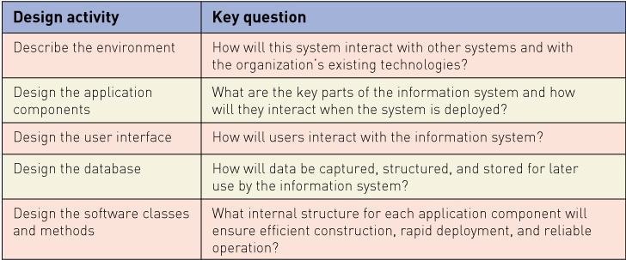
Key Design Questions for each Activity
1.
2.
3.
4.
5.

Slide 18
Revision question What is three-layer architecture or design? Describe the content of each layer (no answer provided - please look up earlier lectures)

Slide 19
1. Describe the Environment
Two key elements in the environment
Communications with external Systems
Message formats
Web and networks
Communication protocols
Security methods
Error detection and recovery
Conforming to an existing technology architecture
Discover and describe existing architecture

Slide 20
2. Design the Application Components
Application component
well defined unit of software that performs some function(s)
Questions to be asked when packaging components together are,
Scope and size – what are the functions, boundaries, interfaces?
Programming language – what are the accepted languages?
Build or buy – is an acceptable version available to purchase?

Slide 21
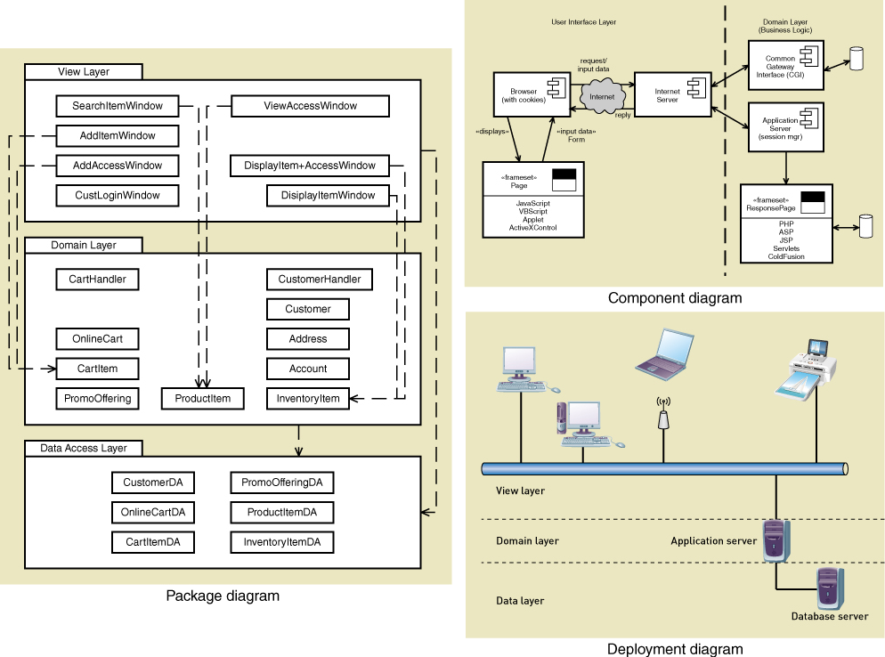
Typical models for defining application components

Slide 22
Which use case description model from the system analysis phase is best suited for User Interface Design?

Slide 23
Answer
All models are useful for UI design
Use case model
System sequence diagram
Activity diagram
Prototypes
Story boards

Slide 24
3. Design the User Interface
To the user, the user interface is the system
The user interface has large impact on user productivity
User involvement is required in both analysis and design tasks
Most systems need multiple user interfaces
Many different devices and environments
Notes:
Activity diagrams in system analysis assists in user interface design.

Slide 25
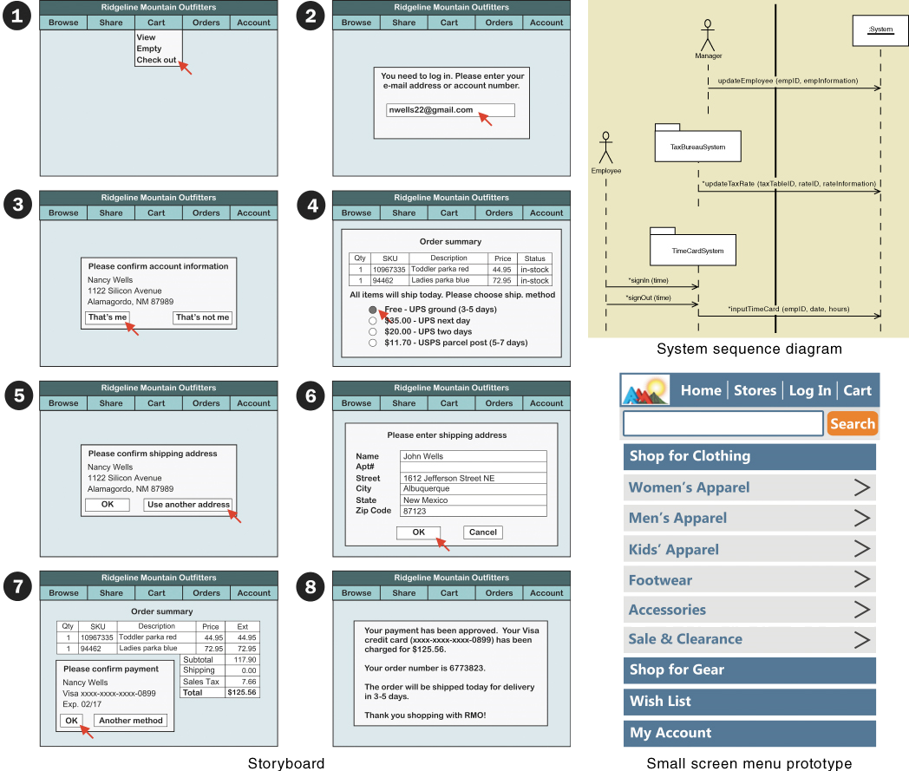
Typical models for user interface design
Notes:
Storyboard: Choose one path where branching is possible and carry on.

Slide 26
4. Design the Database
An Information System requires data – usually in a database
Current technology frequently used Relational Database Management Systems (RDBMS)
Building a database from the Entity Relationship Diagram (analysis task)
Design requires addressing of many other technical issues
Throughput and response time
Security

Slide 27
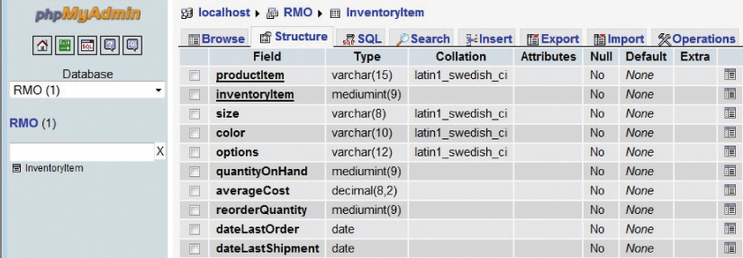
Typical Table Definition as part of Database Schema

Slide 28
5. Design Software Classes and Methods
AKA Detailed Design
A model building activity
Domain class diagrams are elaborated into Class Diagram(s)
System Sequence Diagrams are elaborated into Sequence Diagram(s)
Elaborated = just add more detail

Slide 29
Q. What additional information is provided by the design class diagram compared to the domain model class diagram?

Slide 30
Answer
More attributes
Methods (also called operations)
Visibility (privacy) indictors (+, -, #)
+ public
- private
# protected

Slide 31
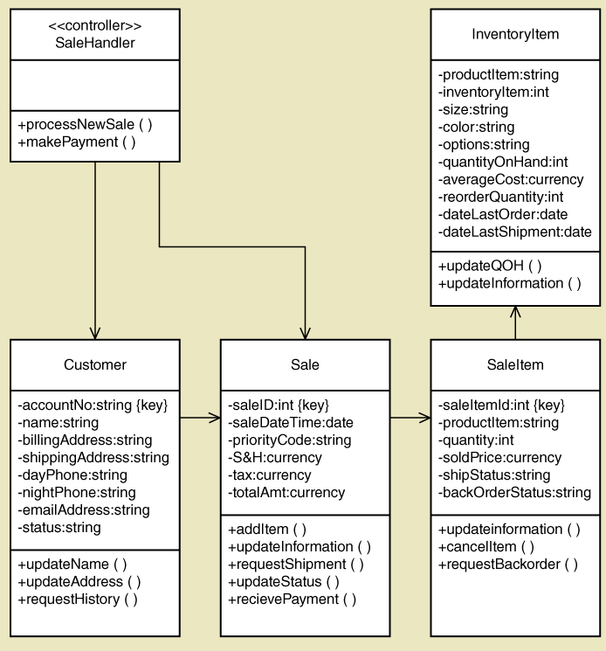
Typical Design Class Diagram with attributes and methods
Note: although this diagram shows arrows it is generally best practice to avoid arrows on a class diagram

Slide 32
Systems Controls and Security

Slide 33
System Controls and Security
Integrity Controls
Controls that maintain integrity of,
Inputs – rejecting invalid data inputs
Outputs – preventing unauthorized data outputs
Data – protect database
Protect application programs being developed
Security Controls
Controls that protect the assets from threats,
Internal – Local Area Network
External – Wide Area Network
Operating systems

Slide 34
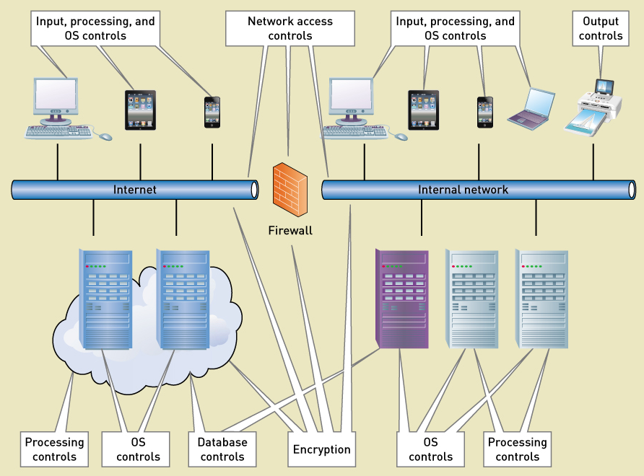
Integrity and Security Controls

Slide 35
Designing Integrity Controls
Integrated into application programs and Database Management Systems (DBMS)
Integrity controls provide
Consistency – ensure that only appropriate and correct business transactions are accepted
Accuracy – ensure that transactions are recorded and processed correctly
Completeness – to protect and safeguard assets such as the database

Slide 36
Input Controls
Prevent invalid or erroneous data from entering the system
Value Limit Controls
Check the range of inputs for reasonableness. For example, Negative price.
Completeness Controls
Ensure all the data has been entered. DOB
Data Validation Controls
Ensure that specific data values are correct. Password has special characters.
Field Combination Controls
Ensure data is correct based on relationships between fields
Notes:
Field Combination Controls
Data being processed has an appropriate primary-key affiliated with it.

Slide 37
Output Controls
To ensure that output arrives at proper destination (for authorized eyes) and is accurate, current, and complete
Examples
Physical access to printers and display devices
Discarded data – protect from ‟dumpster diving”
Labels on printed and electronic output to correctly identify source of data

Slide 38
Redundancy, Backup and Recovery
Protect data and systems from catastrophes
Databases
Hardware
Software applications
Networks
On-site versus off-site copies

Slide 39
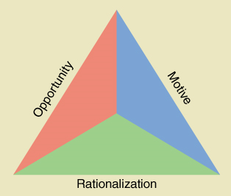
Fraud Prevention
Critical to prevent internal fraud, embezzlement, or loss
Fraud triangle
Opportunity
Motive
Rationalization
Notes:
Opportunity can only be controlled

Slide 40
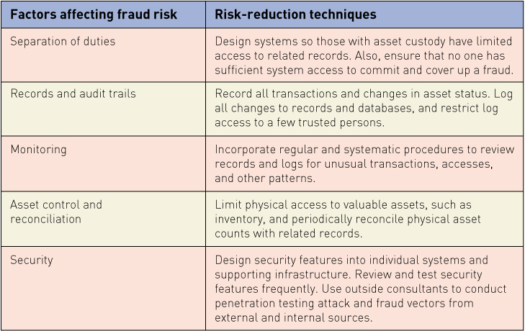
Fraud Risk – Factors and Techniques

Slide 41
Designing Security Controls
Protect all assets against external threats
Other objectives
Protect and maintain a stable, functioning operating environment 24/7 (equipment, operating systems, DBMSs)
Protect information and transactions during transmission across networks and Internet

Slide 42
Designing Security Controls
Access Controls – limit a person’s ability to access servers, files, data, applications
Authentication – to identify users
Multifactor Authentication
Access control list – list of valid users
Authorization – list of permission level for each resource for each user
Registered Users – those with authorization
Unauthorized Users – anyone not registered
Privileged Users – those that maintain lists and systems

Slide 43
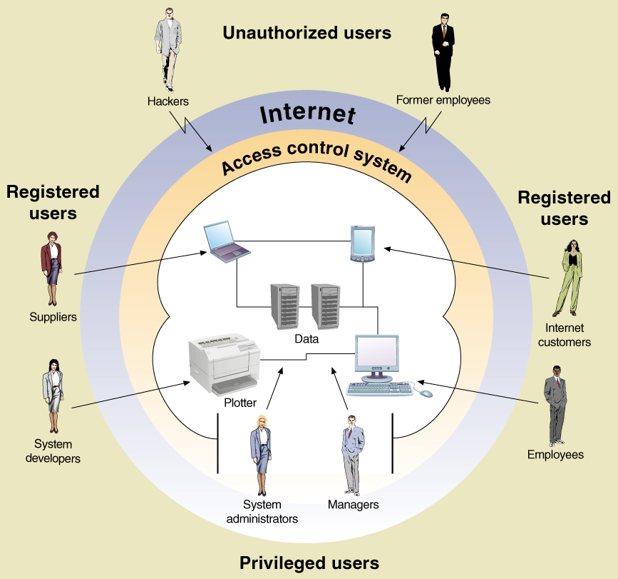
Types of users
Notes:
Privileged users can modify the data model
Registered users can only modify the data in tables (not the model)
Unauthorized users can previously be registered users or they are hackers pretending to be registered users

Slide 44
Data Encryption
Method to secure data – stored or in transmission
Encryption – alter data so it is unrecognizable
Decryption – converted encrypted data back to readable format
Encryption Algorithm – mathematical transformation of the data
Encryption Key – a long data string that allows the same algorithm to produce unique encryptions

Slide 45
Symmetric Key Encryption
Encryption method that uses the same key to encrypt and decrypt

Slide 46
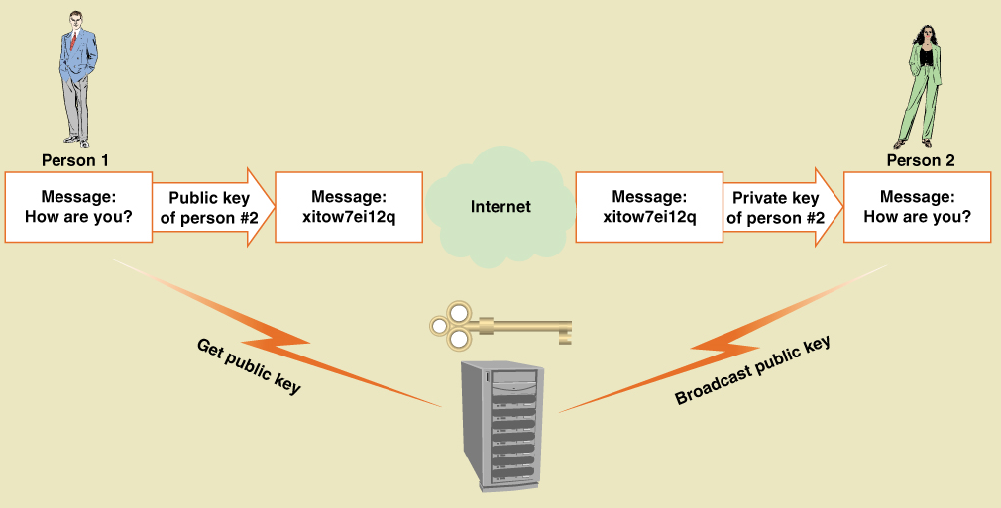
Asymmetric Key Encryption
Encryption method that uses different keys to encrypt and decrypt
AKA Public Key Encryption
Notes:
Recipient broadcasts the public key. Public key is used to encrypt the data. Receiver uses the private key to decrypt the encrypted message. Public key can not be used to decrypt the encrypted message.
Problem: Is it an authorized sender?

Slide 47
Steganography

Slide 48
Digital Signatures and Certificates
Digital Signature – technique where a document is encrypted using a private key
Note – implements previous slide, but in reverse
Document is encrypted with private key, but then can only be decrypted with correct public key
Notes:
Digital signature allows a recipient to be sure that the sender is the expected entity.

Slide 49
Secure Transactions
Secure transactions requires certain standards:
Secure Sockets Layer (SSL) – standard set of protocols for authentication and authorization
Transport Layer Security (TLS) – an Internet standard equivalent to SSL
IP Security (IPSec) – Internet security protocol at a low-level transmission. More secure encryption than SSL
Hypertext Transfer Protocol Secure (HTTPS) – Internet standard to transmit Web pages
Notes:
Secure transactions require authentication, authorization, privacy and integrity.

Slide 50
Summary
This chapter introduces the concept of Systems Design
Analysis is fact finding and modeling
Design is modeling to specify how system will be implemented
Design is bridge between analysis an implementation

Slide 51
Summary (continued)
Activities of Systems Design
Describe the environment
Design the application components
Design the User Interface
Design the database
Design the software classes and methods

Slide 52
Summary (continued)
System Controls and Security
Integrity Controls
Input controls
Output controls
Backup and recovery
Fraud prevention
Security Controls
Access controls
Data encryption
Digital signatures and certificates
Secure transactions

Slide 53
End

