Slide 1
Chapter 4

Slide 2
Chapter 4
Domain models –
The domain class diagram
Part 2
Systems Analysis and Design in a Changing World 7th Ed
Satzinger, Jackson & Burd

Slide 3
History
Relational databases were developed in the 1970s
The ERD model was developed to model these systems
Object-oriented programming languages were developed in the 1980s
In the 1990s the UML class diagram was developed to model these systems
The UML developers copied a lot of the notation and ideas from the old ERD
Both models are for modelling things and their relationships
Both models are still used today

Slide 4
Associations Among Things

Slide 5
Associations Among Things
In the ERD
Things are called entities
Entities are related to one another with a relationship line
Constraints are shown with cardinality symbols
ERDs are models used to develop relational databases
In the domain class diagram
Things are called classes
Classes are related to one another with an association line
Constraints are shown with multiplicity symbols
Domain class diagrams are models used to develop object-oriented computer systems

Slide 6
Introduction
Things and their relationships (associations) are important for understanding the detail of requirements
Things are called domain classes in a domain class diagram
Domain classes are used to model object-oriented systems
Object-oriented systems are created using object-oriented programming languages such as Java, C#, Smalltalk

Slide 7
The Domain Class Diagram
Class
Describes a collection of objects
Class Diagram
One of the 12 UML diagrams
Shows classes with attributes
Shows the associations between classes
A class diagram shows operations (called methods in Java and C#) if the models is used to design software classes
Domain Class
Classes that describe things or objects in the problem domain
Domain Class Diagram
A class diagram that only includes classes from the problem domain
This is not a software model so no methods (operations) are shown

Slide 8
UML Domain Class Notation
Domain class consists of a name and attributes (no methods)
Class name is always capitalized
Attribute names are not capitalized and use camelBack notation (words run together and second word is capitalized)
Compound class names also use camelback notation OrderItem

Slide 9
Associations Among Things
This diagram is called a semantic net in the following slides

Slide 10
A Simple Domain Class Diagram
Note: This diagram matches the semantic net shown in the previous slide
Notes:
zero or more
exactly one
one or more
exactly one

Slide 11
Multiplicity is used to describe constraints in a domain class diagram (e.g. 1 or more)
Multiplicity is shown on the association line between two classes (e.g. 1..*)

Slide 12
UML Notation for Multiplicity

Slide 13
A Simple Domain Class Diagram
Note: This diagram matches the semantic net shown in the earlier slide
A customer places how many order(s)?
An order is placed by how many customer(s)?
An order consists of how many order items?
An order item is part of how many orders?
Notes:
zero or more
exactly one
one or more
exactly one

Slide 14
A Simple Domain Class Diagram
Note: This diagram matches the semantic net shown in the earlier slide
A customer places how many order(s)? – zero or more
An order is placed by how many customer(s)? – one and only one
An order consists of how many order items? – one or more
An order item is part of how many orders? – one and only one
Notes:
zero or more
exactly one
one or more
exactly one

Slide 15
Domain Class Diagram
Example: a bank with many branches
Note notation for the key
Note the precise notation for the attributes (camelBack)
Note the multiplicity notation

Slide 16
Classes will eventually become the classes in an an object-oriented system (a system written in an object-oriented programming language – Java, C#)
Classes are instantiated as objects in a in an object-oriented programming language
A class describes the objects in a system
Class = Student ; Object = “Diane Smith”; Object = “John Kumar”
Class = Product; Object = “War and Peace”; Object = “C# for dummies”
Class = Car; Object = “Mini with license plate PB1234”; “Daimler with license plate PX1243”

Slide 17
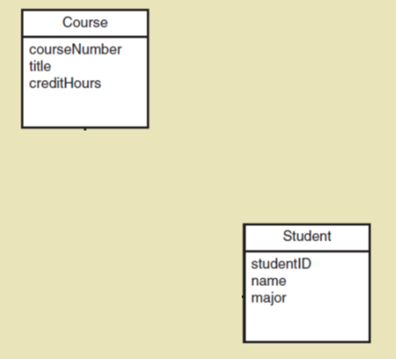
Domain Model Class Diagram
Classes for a course enrollment system at a university
A Course has many Students
A Student can attempt many courses
Problem
How/where to capture student grades?
1..*
1..*

Slide 18
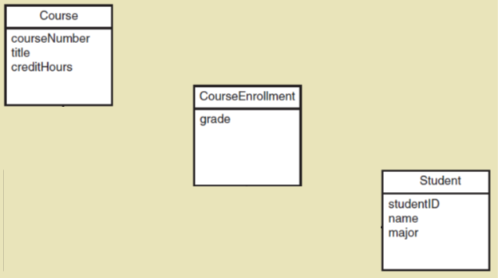
Refined Course Enrollment Model with an Association Class CourseEnrollment
Association class— an association that is treated as a class in a many to many association because it has attributes that need to be remembered (such as grade)
1..*
1..*

Slide 19
Association Class ID
The unique identifier (key) for the association class is the concatenation (join) of the keys of the attached classes
In the previous example the key for CourseEnrollment is CourseNumber+StudentID

Slide 20
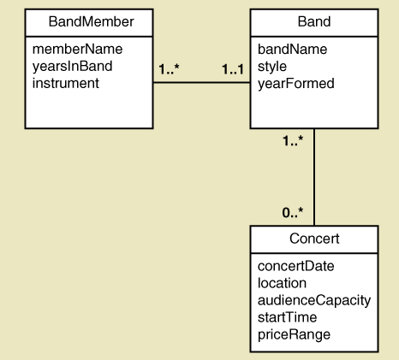
Band with members and concerts
Quick Quiz
How many bands can a person play in?
A band can play in how many concerts?
In a concert, how many bands may be playing?
What attributes can you use for keys? Do you need to add “key” attributes?

Slide 21
Band with members and concerts
Quick Quiz
How many bands can a person play in?
One and only one
A band can play in how many concerts?
Zero or many
In a concert, how many bands may be playing?
One or many
What attributes can you use for keys? Do you need to add “key” attributes?
No, but it helps if the model is to be used for software design
bandMemberID, concertID, bandMemberConcertID

Slide 22
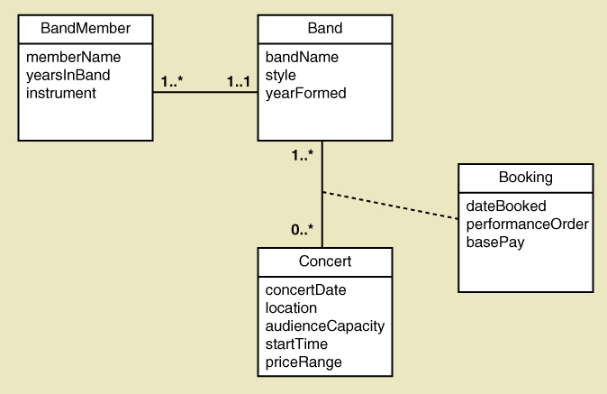
Band with Concert Booking Information
Note: The association class (Booking) also provides a name and meaning for the association
Given the keys you identified, what is the key for the Booking class? Does it uniquely identify instances?
Can multiple bookings be made on the same date by different bands?

Slide 23
More Complex Issues about Classes: Generalization/Specialization Relationships
Generalization/Specialization
A hierarchical relationship where subordinate classes are special types of the superior classes. Often called an Inheritance Hierarchy
Superclass / abstract class
the superior or more general class in a generalization / specialization hierarchy
a class that allow subclasses to inherit its characteristics
it cannot have instances.
Subclass / concrete class
the subordinate or more specialized class in a generalization / specialization hierarchy
a class that can have instances
Notes:
When two or more classes share some same attributes along with some specific attributes.
Then, inheritance is used to classify them as a parent (with common attributes) and child with specific attributes.

Slide 24
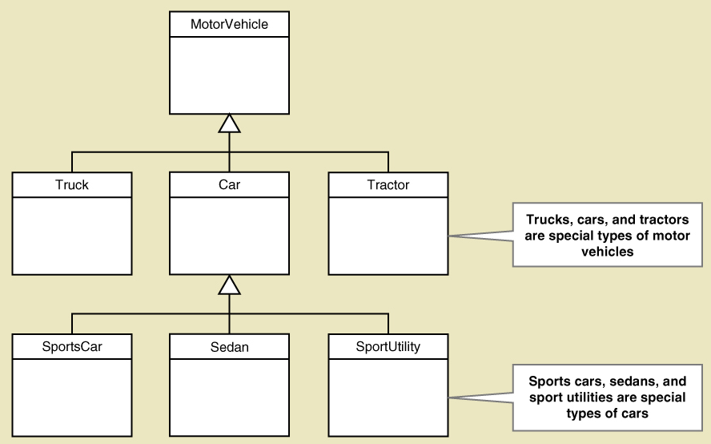
Generalization/Specialization

Slide 25
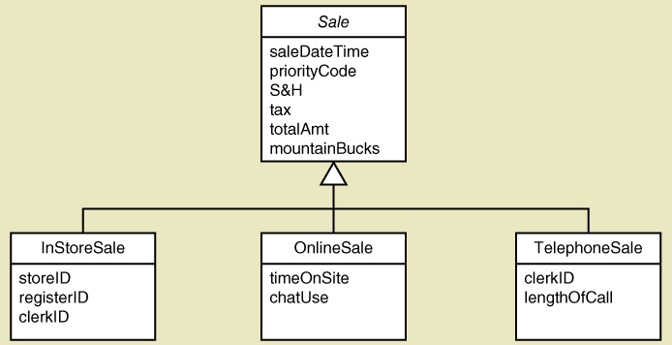
Generalization/Specialization Inheritance for RMO Three Types of Sales
Abstract class (parent) — In Italics (Sale)
Three Concrete classes (children)
Inheritance – Attributes of OnlineSale are:
timeOnSite, chatUse, saleDateTime, priorityCode, S&H, tax, totalAmt…
Note:
A parent must have at least 2 children

Slide 26
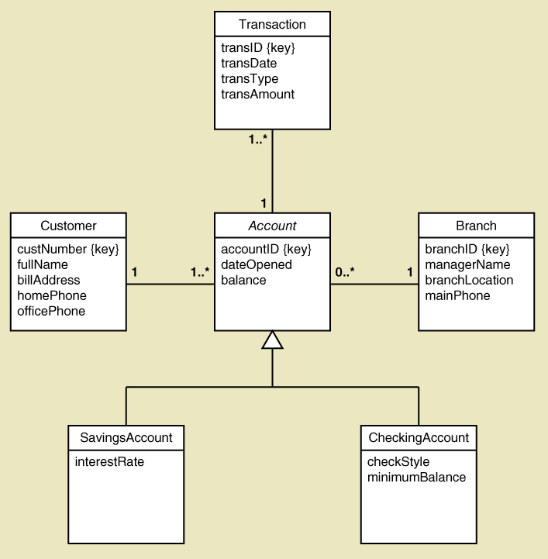
Generalization/Specialization Inheritance for the Bank with Special Types of Accounts
A SavingsAccount has 4 attributes
A CheckingAccount has 5 attributes
Note: the subclasses inherit the associations too

Slide 27
More Complex Issues about Classes: Whole Part Relationships
Whole-part relationship
a relationship between classes where one class is part of another class
Aggregation
a whole-part relationship where a child class can exist independently of the parent class. Removing the parent does not affect the child class (UML diamond symbol on next slide)
Computer has disk storage devices (storage devices exist apart from computer)
Composition
a whole-part relationship where the child cannot be removed; they can’t exist separately
Order uses OrderItems (without the OrderItem(s), there is no Order)
Chip uses circuits (without the circuit(s), there is no chip)
Notes:
System storing information about Computers to be built as well as the storage disks for sale.

Slide 28
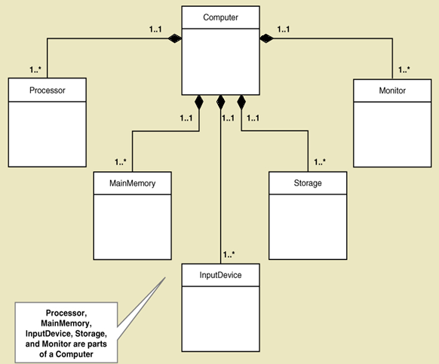
Whole Part Relationships Computer and its Parts
Composition
Describing Computer needs description about Processor, MainMemory, etc.

Slide 29
UML Relationships
Three types of relationships in domain class diagrams
Association Relationships
Associations discussed previously, just like ERD relationships
Whole Part Relationships
One class is a component or part of another class
Generalizations/Specialization Relationships
Inheritance

Slide 30
RMO CSMS Project - Domain Class Diagrams
Ways to organise the domain class diagram
RMO CSMS has 27 domain classes overall (next slide)
Create one overall domain class diagram that gives an overview of the whole system
For a simpler view break down the model
Create one domain class diagram per subsystem
Early in a project complete an initial draft of the domain class diagram and kept up to date as things change
The domain class diagram can be used to organise who does what on a large development project (by subsystem)

Slide 31
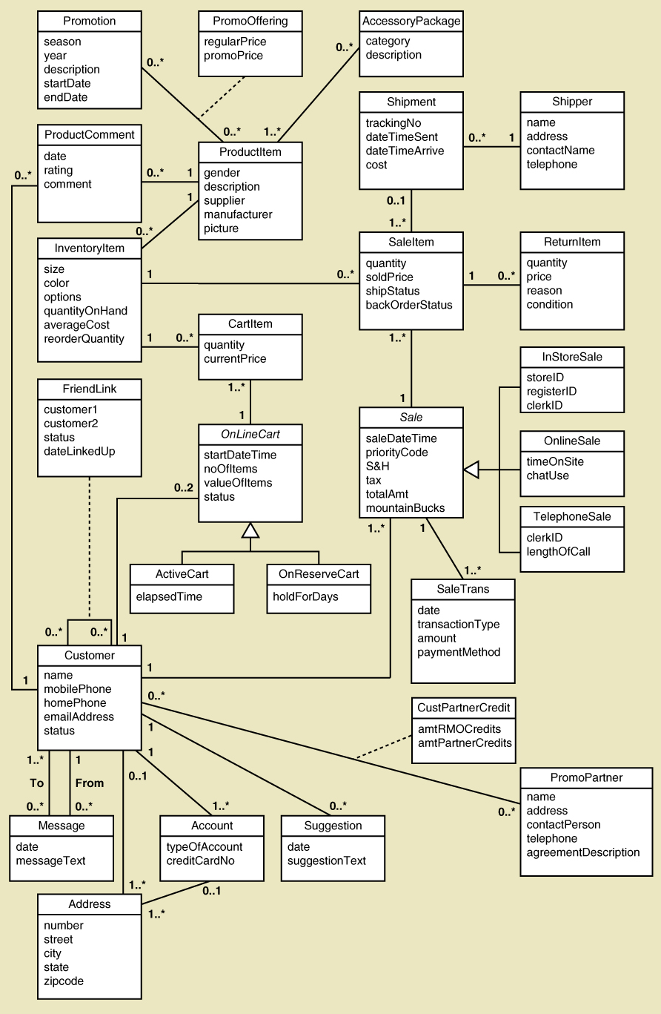
RMO CSMS Project Complete Domain Class Diagram

Slide 32
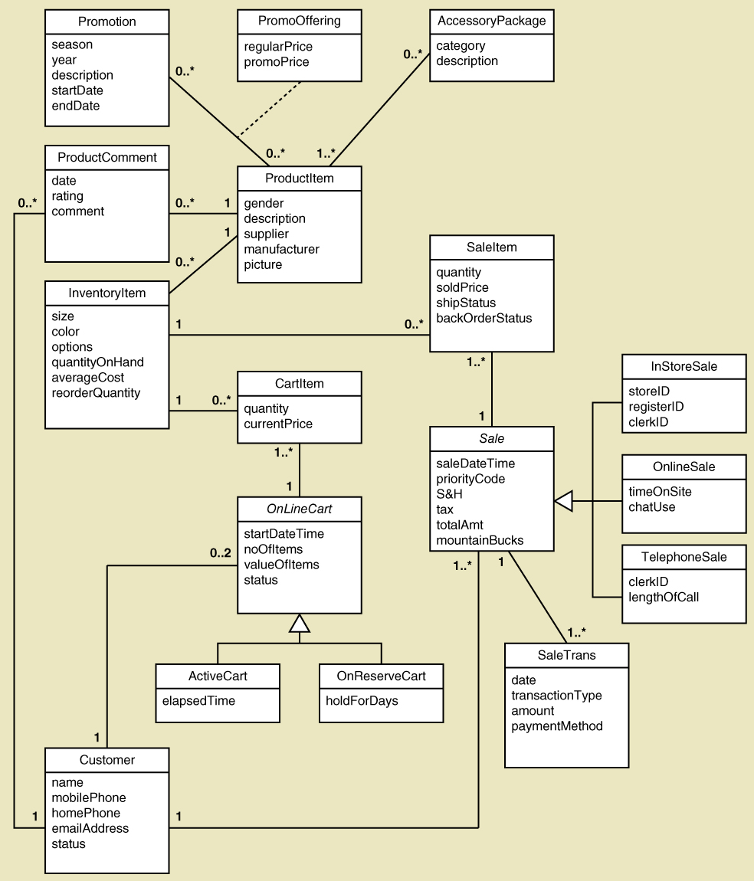
RMO CSMS Project Sales Subsystem Domain Class Diagram

Slide 33
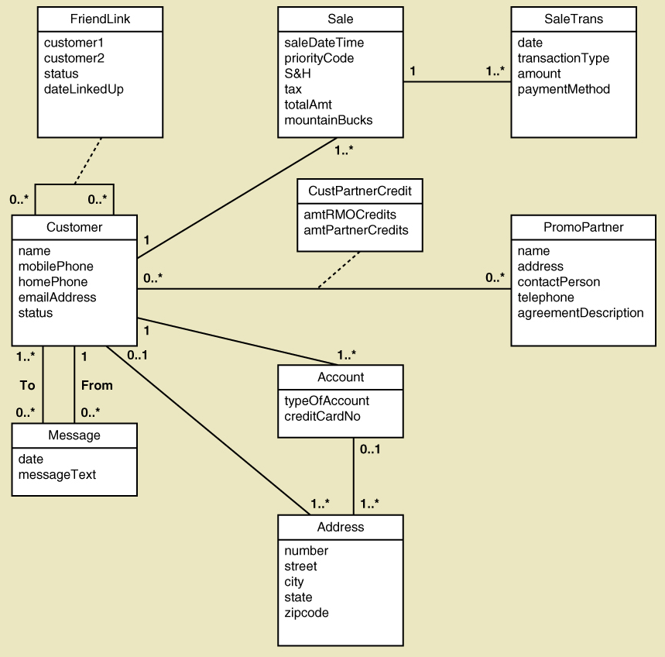
RMO CSMS Project Customer Account Subsystem Domain Class Diagram

Slide 34
To clarify the main differences
Entity Relationship Diagram (ERD)
Domain class diagram
Relationships between entities are defined by relationships
Relationships are in two directions (read separately each way)
A customer places an order
An order is placed by a customer
cardinality is used to identify the number of relationships
0 to 1; 1 to 1; 0 to many; 1 to many
Many to many must be removed
ERDs are used to develop relational databases
Relationships between classes are defined by associations
Associations are in two directions (read separately each way)
A customer places an order
An order is placed by a customer
multiplicity is used to identify the number of associations
0 to 1; 1 to 1; 0 to many; 1 to many;
Many to many is ALLOWED
Classes are used to develop classes in an object-oriented system
Classes are instantiated as objects in an executing system

Slide 35
Design Class Diagram
Is just a more detailed version of the domain class diagram
Domain class diagrams are elaborated into Class Diagram(s)
Elaborated = just add more detail

Slide 36
Q. What additional detail is added to the domain class diagram to create a design class diagram?

Slide 37
Answer
More attributes
Operations (also called Methods)
Visibility indictors
+ public
- private
# protected
Data types can be included
A fully detailed class model can be used to generate programme code (with the right tools)

Slide 38
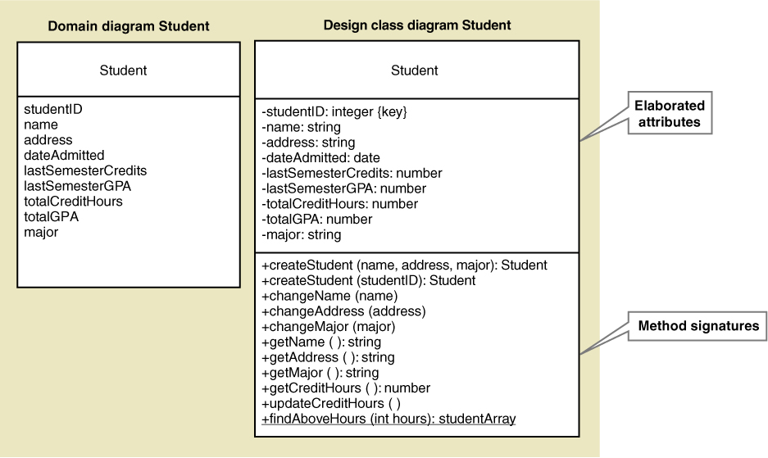
Design Class Diagram Notation

Slide 39
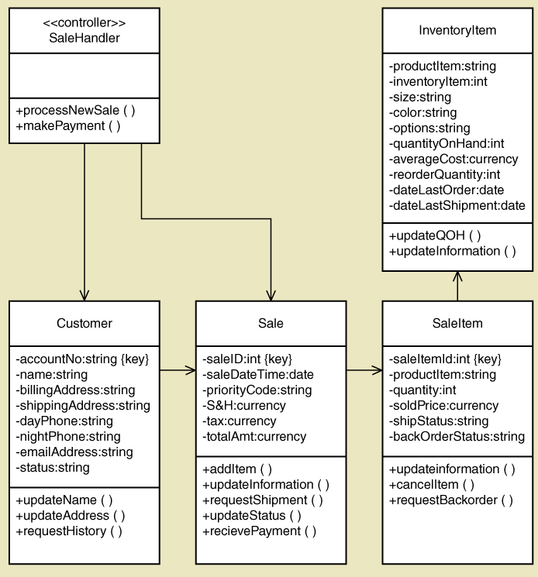
A partial design class diagram showing attributes, operations and visibility indicators
NOTES
1. The associations can also be shown with simple lines and multiplicity (not with arrow heads, as shown – arrows indicate navigation visibility – calls in a programming language – this detail is excluded from the course)
2 This example does not show the data types that are included in the previous slide

Slide 40
Summary of Chapter 4
This chapter focused on domain models for describing functional requirements for a system
“Things” in the problem domain are identified and modelled
Two techniques for identifying domain classes and data entities
the brainstorming technique
the noun technique

Slide 41
Summary of Chapter 4
A model for showing the things in a system and how they are related
Domain class diagram
models domain classes
used for object-oriented design
this is a UML model
A class diagram also has operations (or methods). These diagrams have more detail than the domain class diagram and are sometimes called ‘design class diagrams’. These models are used for software design and can be used to produce software code.

Slide 42
Summary of Chapter 4
There are three UML class diagram relationships
association relationships
generalization/specialization (inheritance) relationships
whole part relationships
Other class diagram concepts
abstract versus concrete classes, compound attributes
composition and aggregation, association classes, super classes and subclasses
END

