Slide 1


Chapter 3

Slide 2
Chapter 3 Use Cases
Part 1
Systems Analysis and Design in a Changing World 7th Ed
Satzinger, Jackson & Burd

Slide 3
Chapter 3 Outline
Use Cases
Use Case creation
  The User Goal Technique
  The Event Decomposition Technique
Use Cases in the Ridgeline Mountain Outfitters Case

Slide 4
Learning Objectives
Explain why identifying use cases is the key to defining functional requirements
Describe two techniques for identifying use cases
  User goal technique
  Event decomposition technique
Describe the notation and purpose for the use case diagram

Slide 5
Use Case Diagrams – basic notation
©2016. Cengage Learning. All rights reserved.
Notes:
Three important notations
A title
Actor
Use case
Association line
Automation boundary is optional

Slide 6
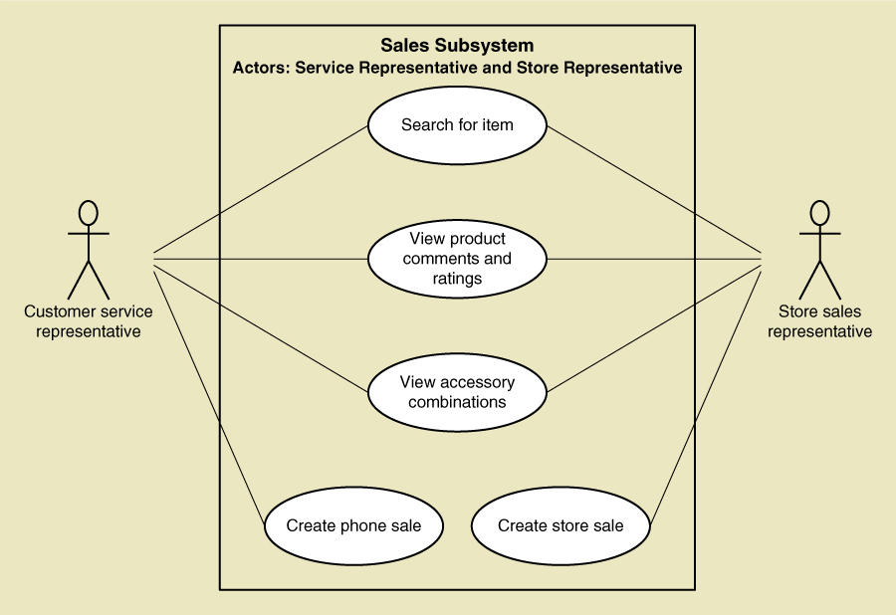
UML Model
Use case diagram

Slide 7
Overview
Chapter 2 provided an overview of
  systems analysis activities,
  functional and non-functional requirements,
  modelling, and information gathering techniques
This chapter focuses on identifying and modelling the key aspect of functional requirements – use cases
In the RMO Tradeshow System from Chapter 1, some use cases are Look up supplier, Enter/update product information, Enter/Update contact information
©2016. Cengage Learning. All rights reserved.
Notes:
In this chapter’s opening case Waiters on Call, examples of use cases are Record an order, Record delivery, Update an order, Sign in driver, Reconcile driver receipts, Produce end of day deposit slip, and Produce weekly sales reports

Slide 8
Revision
Which type of stakeholders can the analyst interact with?
How does the analyst identify which stakeholders to invite to the interview?

Slide 9
Revision
Which type of stakeholders can the analyst interact with?
  Anyone with a ‘stake’ or interest in the system
  Internal stakeholders – inside the organisation
  External stakeholders – outside the organisation
  Operational stakeholders – frequent system users
How does the analyst identify which stakeholders to invite to the interview?
  By asking management and leaders in the organisation
  By looking at the organisation chart or other documents to understand who does what in the organisation
  By studying documents that explain the organisations processes

Slide 10
User Stories
Key-term User: Any stakeholder who uses the system
A User Story is a one-sentence description of a work-related task done by a user to achieve some goal or result
The template for a user story description is:
“As a <role> I want to <goal> so that <benefit>
Acceptance Criteria identifies the features that must be present at the completion of the task
©2016. Cengage Learning. All rights reserved.

Slide 11
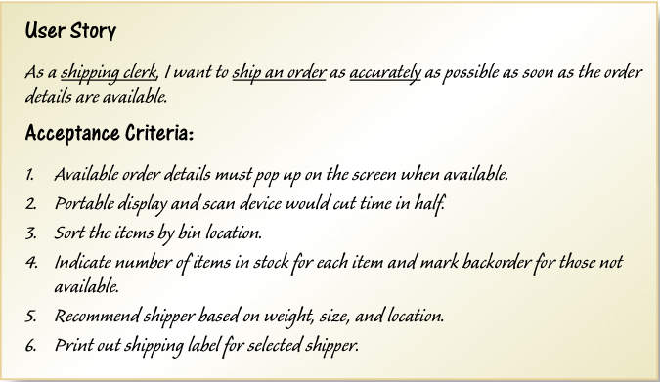
Sample User Story
Acceptance criteria prepared by Analyst can be treated as a contract
and can be used in software testing
©2016. Cengage Learning. All rights reserved.

Slide 12
Use Cases
Use case — an activity that the system performs, usually in response to a request by a user
Use cases define functional requirements
Analysts decompose the system into a set of use cases (functional decomposition)
Two techniques for Identifying use cases
  User goal technique
  Event decomposition technique
Name each use case using Verb-Noun combination
©2016. Cengage Learning. All rights reserved.
Notes:
Temporal event and state event lead to an automated use case which reports to the user automatically

Slide 13
User Goal Technique
This technique is the most common in industry
Simple and effective
Identify all of the potential categories of users of the system
Interview and ask them to describe the tasks the computer can help them with
Probe further to refine the tasks into specific user goals, “I need to Ship items, Track a shipment, Create a return”
©2016. Cengage Learning. All rights reserved.

Slide 14
Problem narrative
A supermarket chain wants to create a new system to improve the workflow at the checkouts. To understand the current system and create a better system, first the analyst needs to understand how the checkout staff carry out their work.
The analyst interviews some checkout staff and also observes how they work.

Slide 15
Class Exercise
Identify use cases based on the narrative by using the questions to users stated below

