Slide 1
Chapter 3

Slide 2
Chapter 3
Use Cases – Part 2
Systems Analysis and Design in a Changing World 7th Ed
Satzinger, Jackson & Burd

Slide 3
Use Case Diagrams – basic notation
©2016. Cengage Learning. All rights reserved.

Slide 4
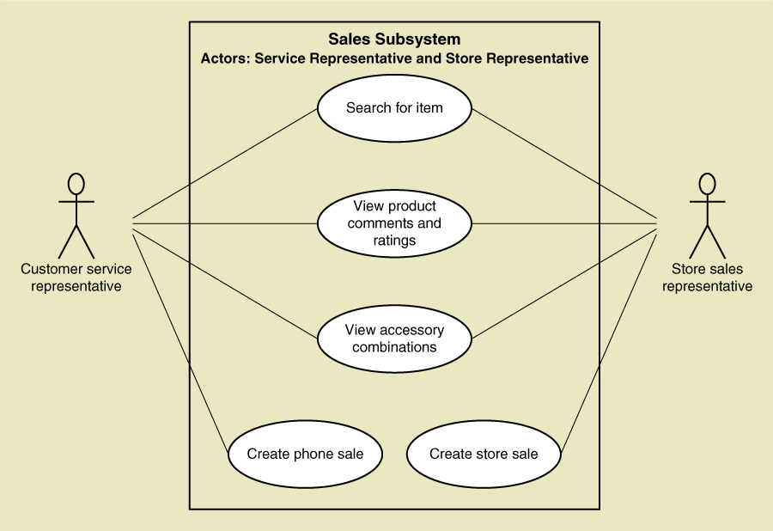
UML Model
Use case diagram
Notes:
The use cases can be shown in any order in the model

Slide 5
The User Goal technique cont.d…
From Part 1

Slide 6
User Goal Technique Some RMO Users and Goals
©2016. Cengage Learning. All rights reserved.

Slide 7
User Goal Technique: Specific Steps
Identify all the potential users for the new system
Classify the potential users in terms of their functional role (e.g., shipping, marketing, sales)
Further classify potential users by organizational level (e.g., operational, management, executive)
For each type of user, interview them to find a list of specific goals they will have when using the new system (current goals and innovative functions to add value)
©2016. Cengage Learning. All rights reserved.

Slide 8
User Goal Technique: Specific Steps (continued)
Create a list of preliminary use cases organized by type of user
Look for duplicates with similar use case names and resolve inconsistencies
Identify where different types of users need the same use cases
Review the completed list with each type of user and then with interested stakeholders
©2016. Cengage Learning. All rights reserved.

Slide 9
Use Case Duplication
Create Order Use case

Slide 10
User Goal Technique: Benefits
Focuses on the stated needs of the end users
Simple to create
©2016. Cengage Learning. All rights reserved.

Slide 11
Event Decomposition Technique
More comprehensive and complete than the User Goal technique
Identify the events that occur to which the system must respond
For each event, name a use case (verb-noun phrase) that describes what the system does when the event occurs
Event – something that occurs at a specific time and place, can be described, and should be remembered by the system
What is the event, when Sue receives a call from customer?
Is it customer calling Sue? Or,
Is a Customer calling a Sales Representative to create an order?
©2016. Cengage Learning. All rights reserved.
Notes:
More focussed on the external environment. The system is considered as a black-box.
Use cases are defined as actions taken as a response to an event.

Slide 12
Defining Events
Define events by focusing on a task that is performed by one person in one place in response to a business event which adds business value and leaves the system in a stable and consistent state
Level of detail for a business event. For example, registering a customer
Writing customer name
Entire process of registering a customer
Events throughout the day of registering customers

Slide 13
Events and Use Cases
©2016. Cengage Learning. All rights reserved.

Slide 14
Types of Events
External Event (most common)
an event that occurs outside the system, usually initiated by an external agent or actor
Temporal Event
an event that occurs as a result of reaching a point in time
State Event
an event that occurs when something happens inside the system that triggers some change
e.g. reorder point is reached for inventory item
©2016. Cengage Learning. All rights reserved.

Slide 15
External Events - CRUD
External agent or actor wants something resulting in a transaction – create
Customer buys a product
External agent or actor wants some information – report
Customer wants to know product details
Sales manager wants update on production plans
External data changed and needs to be updated – update
Customer has new address and phone
Management wants some information – delete
HR wants to delete employee records
©2016. Cengage Learning. All rights reserved.

Slide 16
Temporal Events
Internal outputs needed at points in time
Management reports (summary or exception)
Operational reports (detailed transactions)
Internal statements and documents (including payroll)
External outputs needed at points of time
Statements, status reports, bills, reminders
©2016. Cengage Learning. All rights reserved.

Slide 17
Finding the actual event that affects the system
©2016. Cengage Learning. All rights reserved.

Slide 18
Waiters on Call Meal-Delivery System
Which type of event is it when,
Sue creates an order
Delivery driver’s vehicle updating its location on delivery system through GPS
Driver indicates that they are available
Driver receives a report about order to pick up
Sue changes the order
Restaurant receives the updated order
Restaurant updates the time to pick up the order
Driver receives the updates about pick up time

Slide 19
Waiters on Call Meal-Delivery System
Which type of event is it when,
Sue creates an order - external
Delivery driver’s vehicle updating its location on delivery system through GPS – external
Driver indicates they are available - external
Driver receives a report about order to pick up - temporal
Sue changes the order - external
Restaurant receives the updated order - temporal
Restaurant updates the time to pick up the order - state
Driver receives the updates about pick up time - temporal

Slide 20
Tracing a sequence of transactions resulting in many events
©2016. Cengage Learning. All rights reserved.

Slide 21
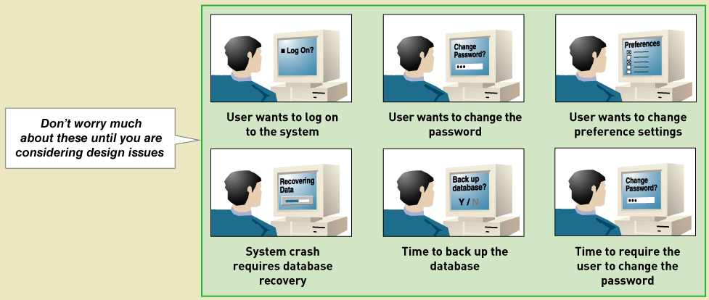
Perfect Technology Assumption
Don’t worry about functions built into system because of limits or changes in technology and people.
Wait until design.
©2016. Cengage Learning. All rights reserved.
Notes:
This detail is partially covered later in the use case description. Next chapter.

Slide 22
Event Decomposition Technique: Specific Steps
Consider the external events in the system environment that require a response from the system
For each external event, identify and name the use case that the system requires
Consider the temporal events that require a response from the system
For each temporal event, identify and name the use case that the system requires and then establish the point of time that will trigger the use case
Use a table like this one
Event Name | Event Type | Use case Name | Actor
©2016. Cengage Learning. All rights reserved.
Notes:
Who is initiating: Event Type
Time: Temporal
Actors: External
Sensor, variable: State

Slide 23
Event Decomposition Technique: Specific Steps (continued)
Consider the state events that the system might respond to, particularly if it is a real-time system in which devices or internal state changes trigger use cases
For each state event, identify and name the use case that the system requires and then define the state change
When events and use cases are defined, check to see if they are required by using the perfect technology assumption. Do not include events that involve such system controls as login, logout, change password, and backup or restore the database, as these are put in later
©2016. Cengage Learning. All rights reserved.
Notes:
Low on stock is the most relevant state event for information systems

Slide 24
Problem Waiters on Call Meal-Delivery System
What is the use case name and who is the actor?
Sue creates an order
Delivery driver’s vehicle updating its location on delivery system through GPS
Driver indicates that they are available
Driver receives a report about order to pick up
Restaurant receives the updated order
Restaurant updates the time to pick up the order

Slide 25
Problem Waiters on Call Meal-Delivery System
What is the use case name and who is the actor?
Sue creates an order
Actor: Customer; UC: create an order
Delivery driver’s vehicle updating its location on delivery system using GPS
Actor: Driver; UC: update driver location
Driver indicates that they are available
Actor: Driver; UC: indicate availability
Driver receives a report about order to pick up
Actor: Driver: UC: receive order
Restaurant receives the updated order
Actor: Restaurant; UC: receive updated order
Restaurant updates the time to pick up the order
Actor: Restaurant; UC; update pickup time

Slide 26
Event Decomposition Technique: Benefits
Includes external, temporal, and state events
Focuses on business processes (the sequence of events)
Uses perfect technology assumption
©2016. Cengage Learning. All rights reserved.

Slide 27
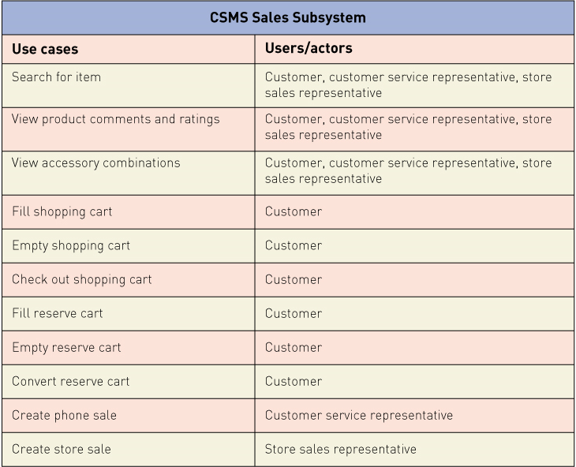
RMO CSMS Project Use Cases
©2016. Cengage Learning. All rights reserved.

Slide 28
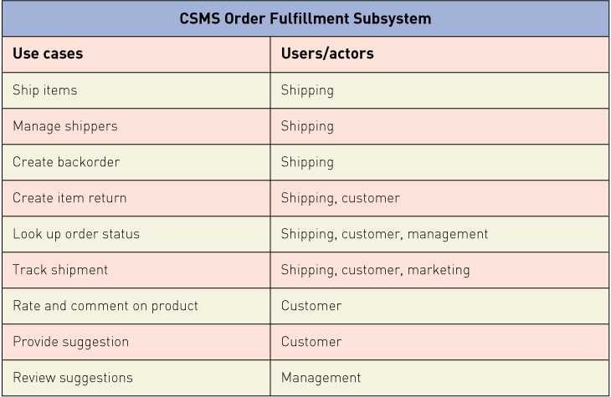
RMO CSMS Project Use Cases
©2016. Cengage Learning. All rights reserved.

Slide 29
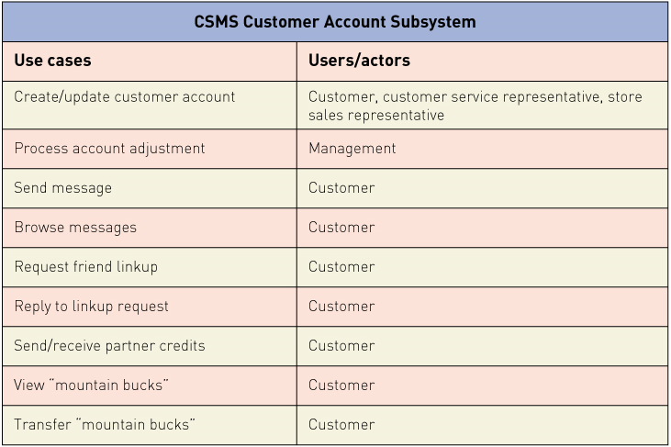
RMO CSMS Project Use Cases
©2016. Cengage Learning. All rights reserved.

Slide 30
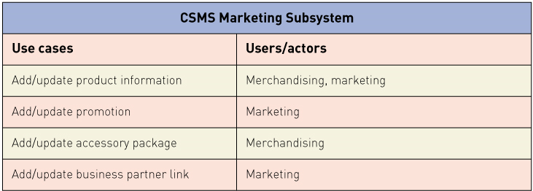
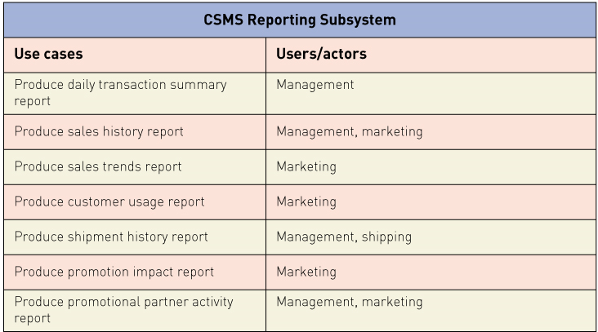
RMO CSMS Project Use Cases
©2016. Cengage Learning. All rights reserved.

