Slide 1


Chapter 5

Slide 2
Use Case Modelling Detail
– UC Descriptions and Activity Diagram
Chapter 5
Systems Analysis and Design in a Changing World 7th Ed
Satzinger, Jackson & Burd

Slide 3
Chapter 5 Outline
Use Case Descriptions
Activity Diagrams for Use Cases
Use Cases validation with CRUD analysis

Slide 4
Overview
Functional requirements are described using
  Use case models
  Domain class models
Brief use case descriptions are simple descriptions of a use case in a few sentences
Fully developed use case descriptions provide information about each use case, including actors, stakeholders, preconditions, post conditions, the flow of activities and exception conditions
Activity diagrams show the flow of activities for a single use case, for part of a system or for a whole system

Slide 5
Use Case Diagram
- from Chapter 3
©2016. Cengage Learning. All rights reserved.

Slide 6
Use Case Descriptions
Brief description of a use case (from Chapter 3)
A fully developed use case description provides more information

Slide 7
Use Case Descriptions
Write a fully developed use case description for more complex use cases
Typical use case description template includes:
  Use case name
  Scenario (if needed) particularly when multiple actors can interact with a use case. So, describing the scenario from a particular actor’s perspective
  Triggering event
  Brief description
  Actor
  Related use case(s) (<<includes>>)
  Stakeholder(s)
  Precondition(s)
  Post-condition(s)
  Flow of activities
  Exception condition(s)

Slide 8
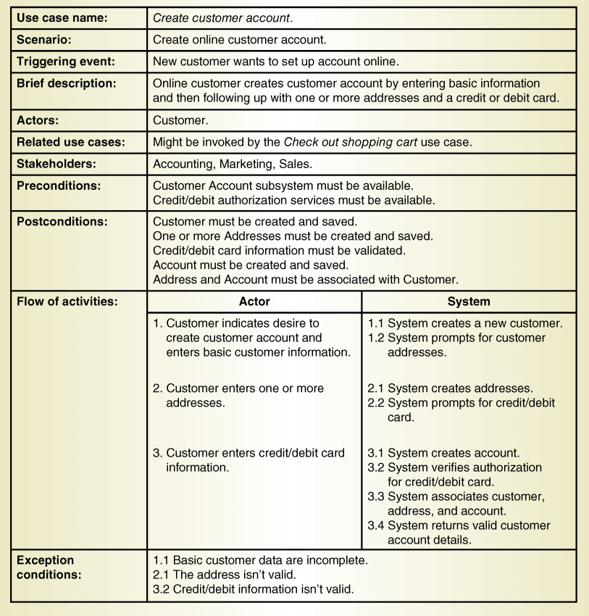
Fully Developed Use Case Description
Use case: Create customer account

Slide 9
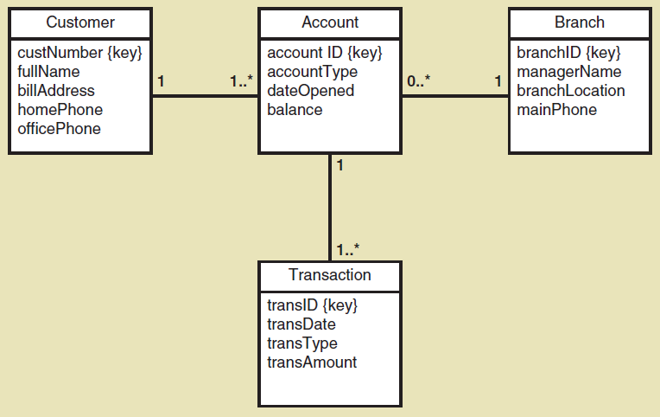
Class Exercise: Domain Model Class Diagram
    Note notation for the key
    Note the precise notation for the attributes (camelBack)
    Note the multiplicity notation

Slide 10
Fully Developed Use Case Description Create customer account (part 1 )
Notes:
Post conditions: One or more Addresses means that a customer class can interact with an Address class. Similarly there is an Account class. Post conditions is just determining that the database records are in stable state.

Slide 11
Fully Developed Use Case Description Create customer account (part 2 )
Notes:
Flow of activities uses the perfect technology assumption. There are no negative paths. However, all possible negative paths are covered in exception conditions.

Slide 12
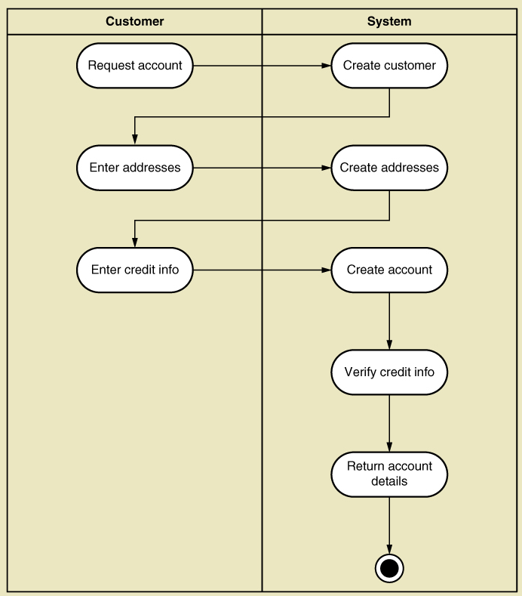
UML Activity Diagram for Use Case
Create Customer Account
Note: this shows flow of activities only

Slide 13
UML Activity Diagram for Use Case
Create Customer Account
Note: this shows flow of activities only

Slide 14
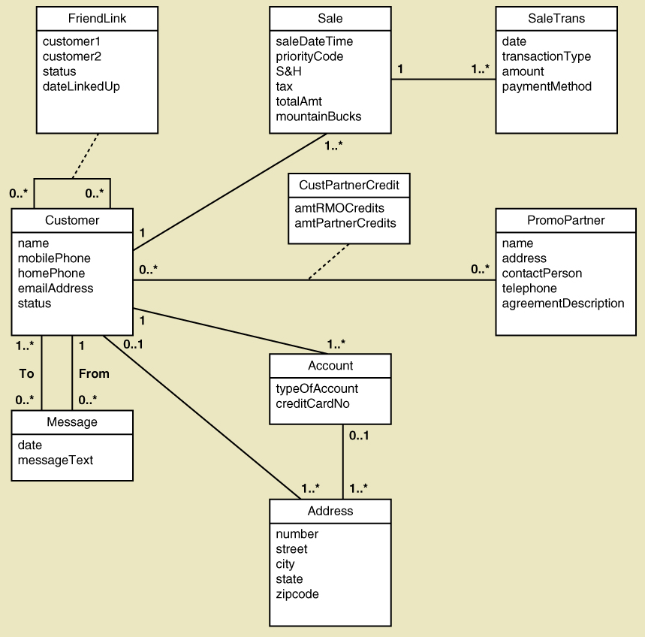
Domain Model Class Diagram
Identify classes used in a use case.
Create customer account use case needs classes like Customer, Account, and Address

Slide 15
Use Case Description Details
Use case name
  Verb-noun
Scenario (if needed)
  A use case can have more than one scenario (special case or more specific path)
Triggering event
  Based on event decomposition technique
Brief description
  Written previously when use case was identified
Actors
  Only one user from use case diagrams
Notes:
Create order is a use case which can be described for different scenarios depending on how the customer places an order. On the phone, in-store or online.

Slide 16
Use Case Description Details
Related use cases <<includes>>
  If one use case invokes or includes another
Stakeholders
  Anyone with an interest in the use case
Preconditions
  What must be true before the use case begins
Post conditions
  What must be true when the use case is completed
  Use for planning test case expected results
Flow of activities
  The activities that go on between actor and the system
Exception conditions
  Where and what can go wrong (password invalid etc.)

Slide 17
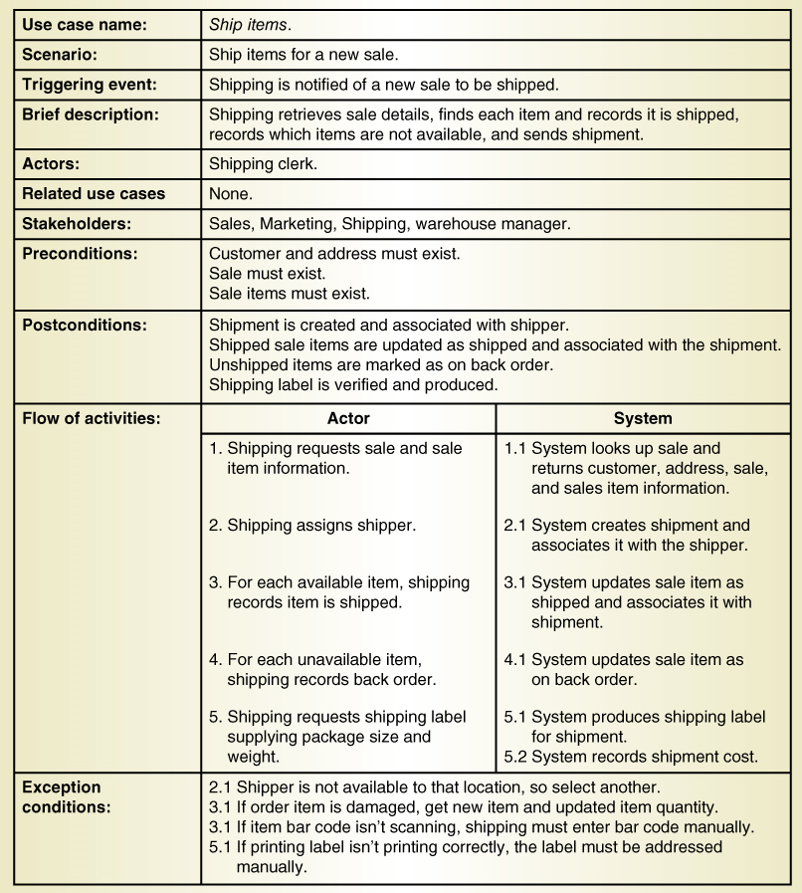
Another Fully Developed Use Case Description Example
Use case
Ship items
Notes:
Although the Shipping clerk is managing the shipment here. However, shipped item record once updated would need the involvement of other departments and users (AKA stakeholders).

Slide 18
Fully Developed Use Case Description
Ship items (part 1 )

Slide 19
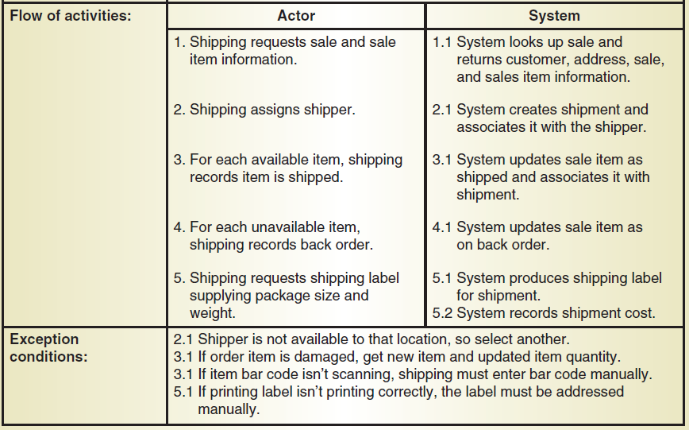
Fully Developed Use Case Description
Ship items (part 2 )

Slide 20
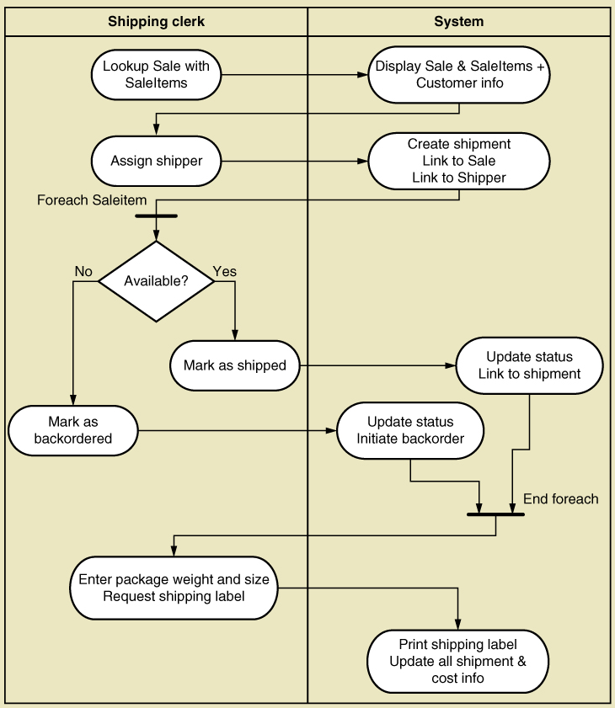
Activity Diagram for
Ship Items Use Case
Note:
  Synchronization bar for loop
  Decision diamond
  Swim lanes (optional)

Slide 21
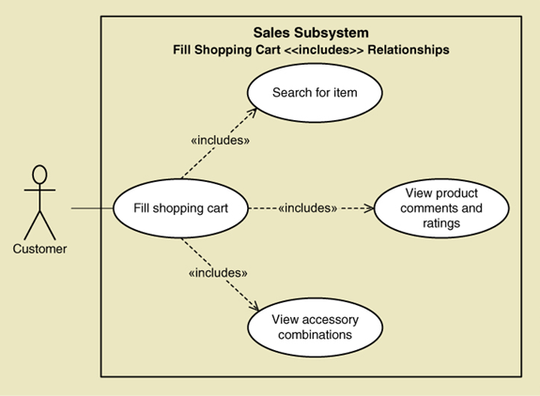
Chapter 3 – The <<Includes>> relationship in a Use Case Diagram
A relationship between use cases where one use case is included within the other use case (includes relationship means the included use case is optional)
©2016. Cengage Learning. All rights reserved.
Notes:
Use the uses key-word between use cases

Slide 22
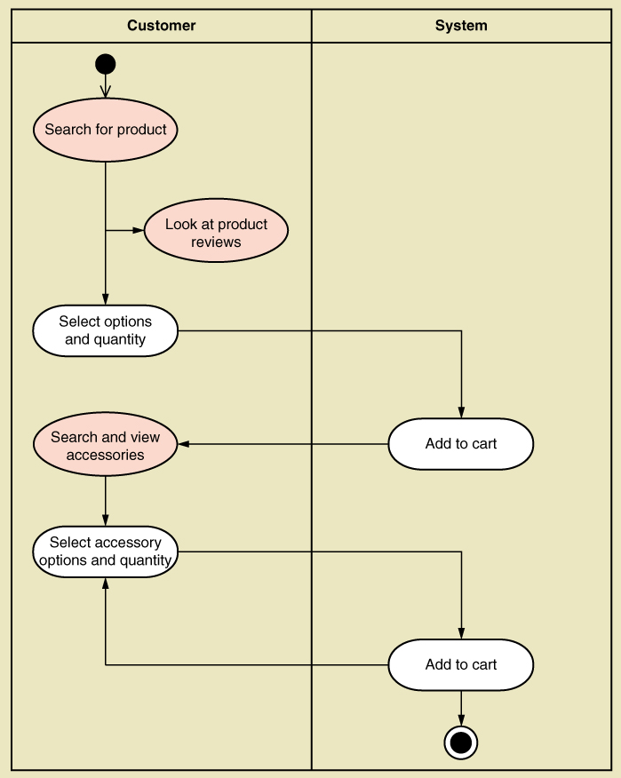
UML Activity Diagram for Use Case
Fill shopping cart
Note: this shows use case with <<includes>> relationship added

Slide 23
Use Cases and CRUD
CRUD technique –
  Create
  Read/Report
  Update
  Delete
A method for cross-checking or validating that each class has use cases that create, read, update, and delete (or archive) the class

Slide 24
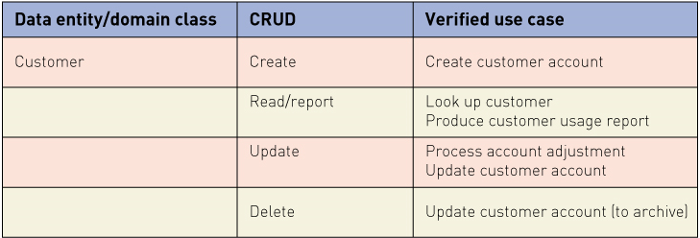
CRUD analysis - use cases for the Customer class

Slide 25
CRUD Analysis
Steps
Identify all domain classes
For each class verify that use cases exist to
  Create a new instance
  Update existing instances
  Read or report on information in the class
  Delete or archives inactive instances of a class
Add new use cases as required.
Identify responsible stakeholders for any new use cases
Identify which sub-system the new use cases belong to

Slide 26
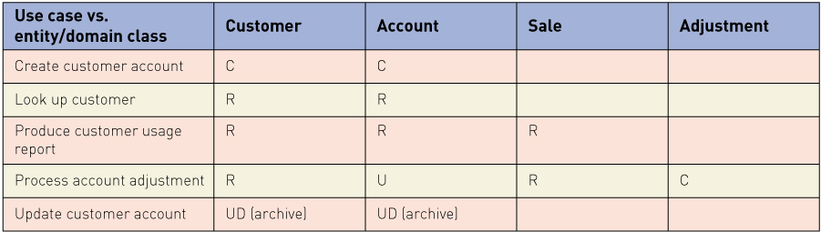
CRUD Matrix
A tool for identifying the complexity of a use case. A sample is presented below.
Process account adjustment use case interacts four classes i.e. Customer, Account, Sale and Adjustment. So it is more complex than the Create customer account use case.
In this system, the Sale class should have use cases for creating, updating and “deleting” Sale objects/instances as well.

Slide 27
Extending and Integrating Requirements Models
Three main UML models for describing functional requirements
Use cases
  Use case diagram can be expanded with …
    Use case description
    Fully developed use case description
    Activity diagram
Activity diagram
Domain Classes
  Domain model class diagram

Slide 28
Summary
This lecture focused on models that show the detail of a use cases
Fully developed use case description provides information about each use case, including actors, stakeholders, preconditions, post conditions, flow of activities and exceptions conditions
Activity diagrams can also be used to show the flow of activities for a use case and for any process or flow of events

Slide 29
Summary (continued)
CRUD analysis is used to check or validate that all domain classes are fully supported by the new system, i.e. have use cases to fully process all required actions
Use case models and domain class diagrams can be made consistent with CRUD analysis
Not all use cases and domain classes are modelled at a detailed level
Only model when there is complexity and a need to communicate details
All of the models must be consistent and integrate together to provide a complete picture of the requirements and the system specification

