Slide 1


Chapter 7

Slide 2
Defining the System Architecture
Chapter 7
Systems Analysis and Design in a Changing World 7th Ed
Satzinger, Jackson & Burd

Slide 3
Chapter 7 Outline
Anatomy of an Information System
Architectural Concepts
Interoperability
Architectural Diagrams
Describing the Environment
Designing Application Components

Slide 4
Learning Objectives
Explain architectural concepts that influence system design, including
Ubiquitous computing and software
Components
Protocols
Interoperability
Distributed architecture
Diagrams
Location, network, and deployment diagrams

Slide 5
Learning Objectives
Describe a system’s environment
by drawing architectural diagrams
answering key questions
Design larger application components based on
use cases
other analysis models

Slide 6
Overview
An important part of new system development and major enhancements is choosing appropriate technologies
Explain and provide a summary of technology and architectural concepts
Describe the details for the activity
Describe the environment
Design the application components

Slide 7
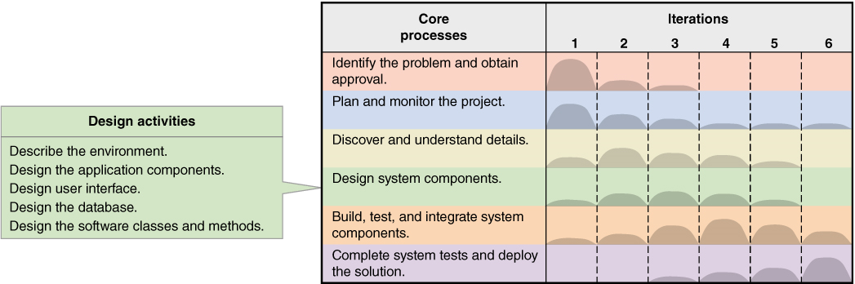
Activities of “Design System Components”

Slide 8
Anatomy of a System 1. Computing Devices
Server
Manages shared resources and enables users and other computers access to these resources
Personal computing devices or clients
Desktops, laptops, tablets, smartphones…

Slide 9
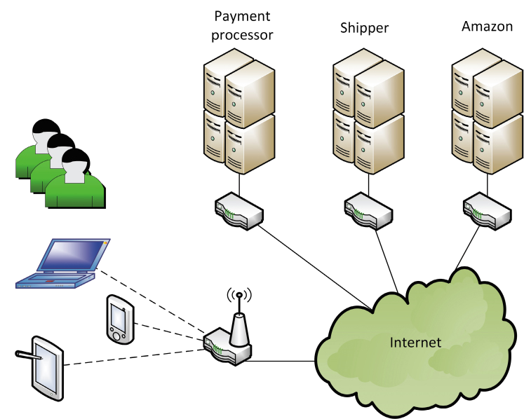
Simplified architecture for application (e.g. Amazon.com)

Slide 10

Server Farm –
Very large databases and very high use

Slide 11
Anatomy – 2. Networks
Computer network – hardware, software, transmission media
Internet backbone –
High-capacity with high-bandwidth trunk lines and large high-speed computers
Owned by governments and telecom companies
Local area network (LAN) –
Small network for a single site
World Wide Web (WWW)
All the interconnected resources accessed through the Internet

Slide 12
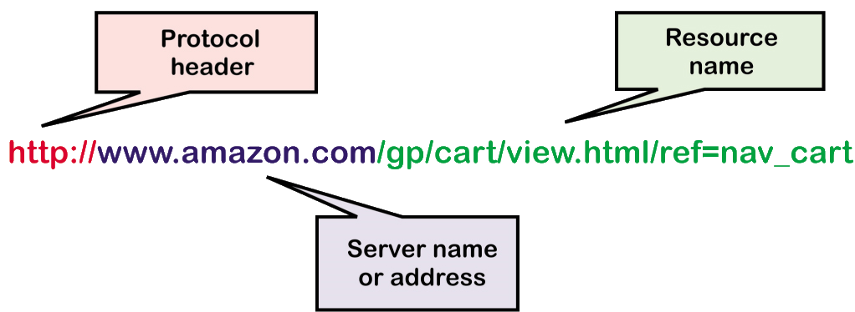
Anatomy – 2. Networks
Uniform Resource Locator (URL)
The identifier for the Web to locate a particular resource
Hyperlink –
The URL of a resource embedded within another resource

Slide 13
Anatomy – 3. Software
Application software
Programs that perform work for users
Either a custom app or a web-based application
App
A custom program usually for a laptop or smartphone
System Software
Behind the scene software, works as glue to hold everything together

Slide 14
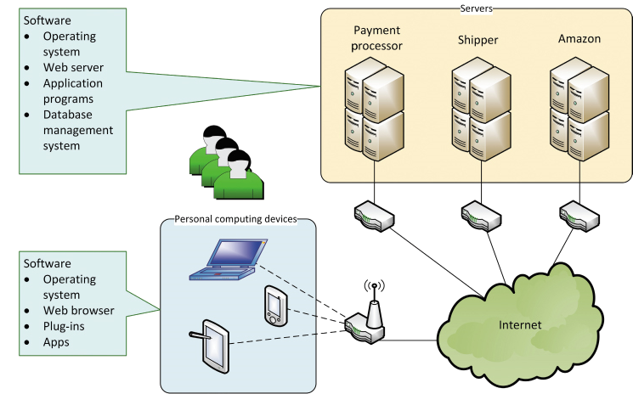
Anatomy – 3. Software

Slide 15
Anatomy – 3. Software
Web-Based Applications
Uses a web browser
Accessed through a URL
Resides on a web server
Uses standard IP protocols
Embedded Software
Software apps or functions embedded within another app, such as within a browser or O/S
Toolbars, plug-ins, widgets

Slide 16
Anatomy – 4. Protocols
Protocol
A set of languages and rules to ensure communication and data exchange between hardware and software
Network protocols
Virtual Private Network (VPN)
Creates a private network but on the Internet by using secure technologies and encryption

Slide 17
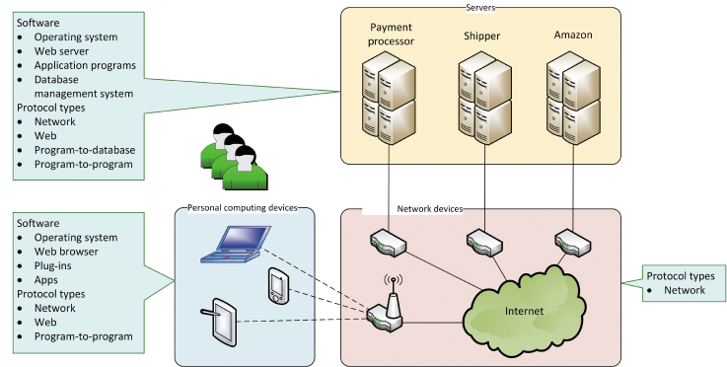
Anatomy – 4. Software and Protocols

Slide 18
Anatomy – 4. Web Protocols
HTML (hypertext markup language)
Protocol for the structure and content of a Web page
XML (extensible markup language)
An extensions of HTML that enables defining semantics of tags
HTTP (hypertext transfer protocol)
Defines format and content for transfer of Web documents
HTTPS (hypertext transfer protocol secure)
Encrypted and secure http transfers

Slide 19
Architectural Concepts
Technology architecture
Computers +
Network computers +
Hardware +
System software
Application architecture
The software programs and their configuration

Slide 20
Software as a Service (SaaS)
SaaS
No software is installed on the user’s device
Application services is accessed remotely
User data is isolated and stored on common servers

Slide 21
Web Services
Web service
Software function that is executed with Web standards
Access via a URL
Inputs sent via the URL
Executes remotely
Data returned within a Web page

Slide 22
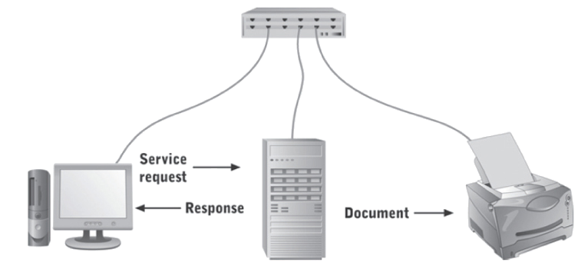
Distributed Architectures
Client/Server architecture
Software design with part of the application on a server and part on the client

Slide 23
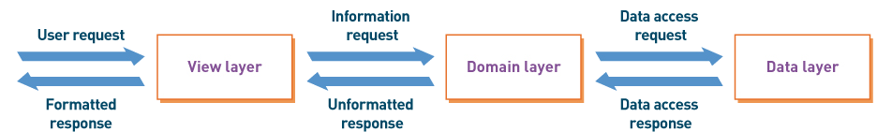
Distributed Architecture
Three-Layer architecture
Client/server architecture with application divided into view layer, logic layer, and data layer
View layer – the user interface
Logic layer – program logic to implement the functions
Data layer – the functions to access the data

Slide 24
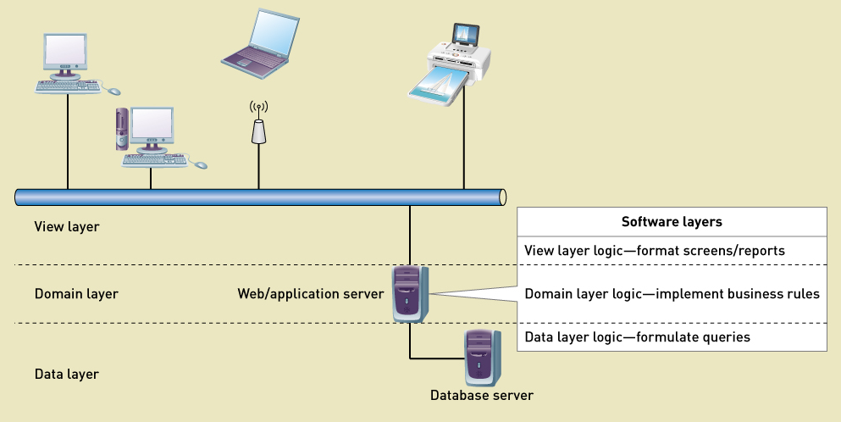
Three Layer Architecture

Slide 25
Interoperability
Interoperability
The ability of an application to interact with other software
Important characteristic in current development projects
Understand the environment
Reuse software existing components (purchased or in-house)
Build components considering interoperability
Combine all components into a solution system

Slide 26
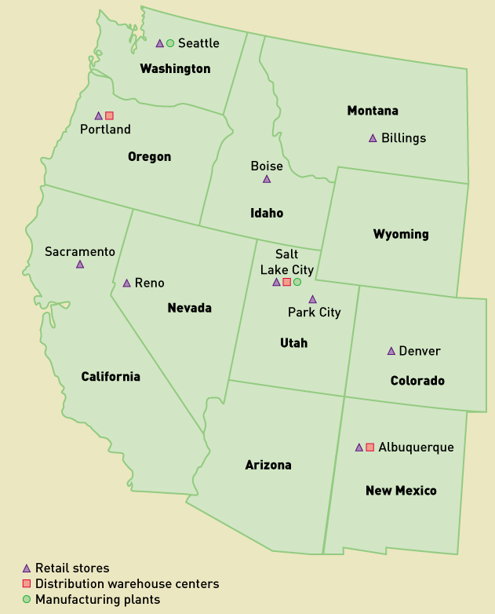
Diagrams for System Architectures
Location Diagram
Identifies the geographical placement of hardware, software, and users

Slide 27
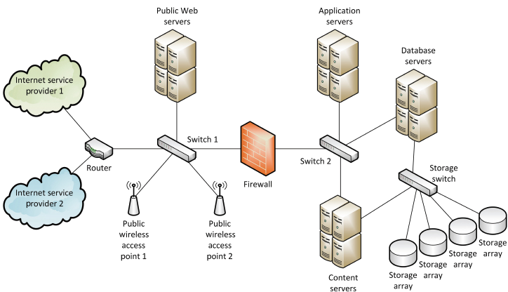
Diagrams for System Architecture
Network Diagram
Shows how locations and hardware components are interconnected with network devices and wiring
There is no specific notation for a network diagram
This is an example of a network diagram

Slide 28
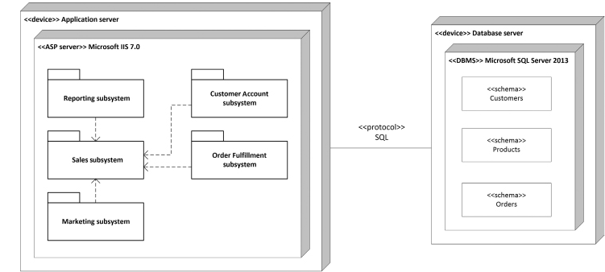
Diagrams for System Architecture
Deployment Diagram
Shows how software components are distributed across hardware and system software components
A deployment diagram is a UML diagram with specific notation

Slide 29
Describing the Environment
Key questions to accurately describe the environment
What are the key features of the existing or new environment?
O/S, system software, networks, tools?
What are the external systems or DBMSs?
What kind of interaction?
What is the data?
What are the protocols?
What kind of security?

Slide 30
Describing the Environment
Key questions to help describe accurately
What devices will be required
Protocols for devices?
Security?
What APIs (application programming interface)?
What user-interface technology will be used
Where and who are users, and what skills?
What hardware and devices?
What client O/S will be used?
Security requirements?
What APIs are needed?

Slide 31
API
An application program interface (API) is a set of routines, protocols, and tools for building software applications.
An API specifies how software components should interact.
Additionally, APIs are used when programming graphical user interface (GUI) components.

Slide 32
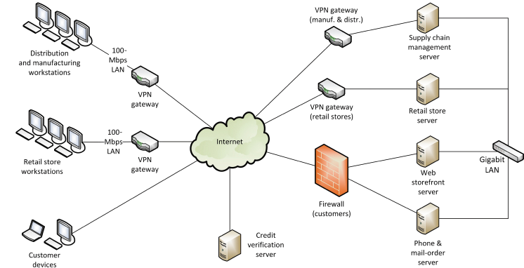
RMO Environment - Existing
Current environment prior to new development

Slide 33
RMO Environment - Proposed
More mobile devices and apps
Web application software and content
Social networking applications
Security issues
External hosting of portions

Slide 34
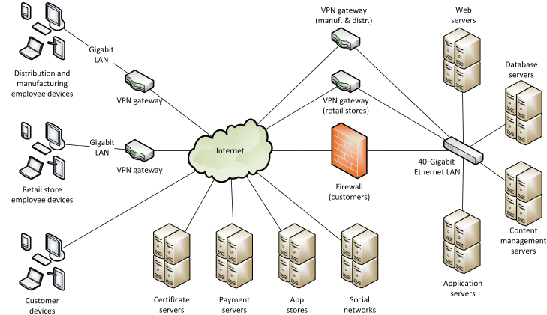
RMO Environment - Proposed

Slide 35
Designing Application Components
Application Component Boundaries
Which components perform which functions
How to group functions to build components
Actors – what functions to particular actors use
Shared data – what functions use the same data
Events – what functions occur in common business events

Slide 36
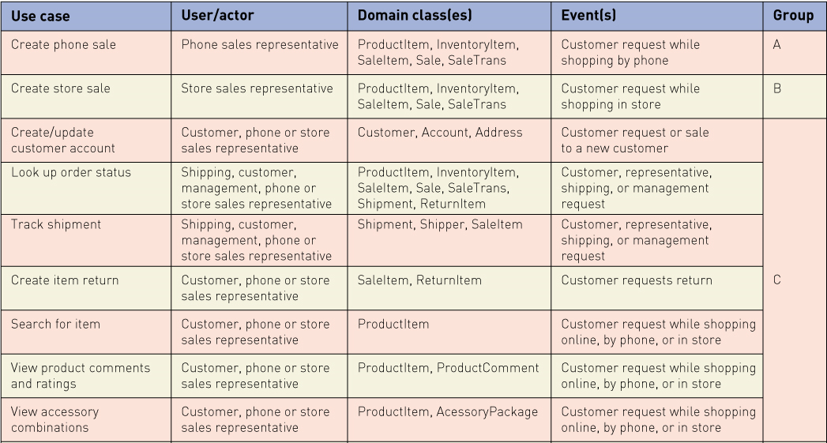
RMO CSMS Application Architecture
Grouping by customer actor – part 1

Slide 37
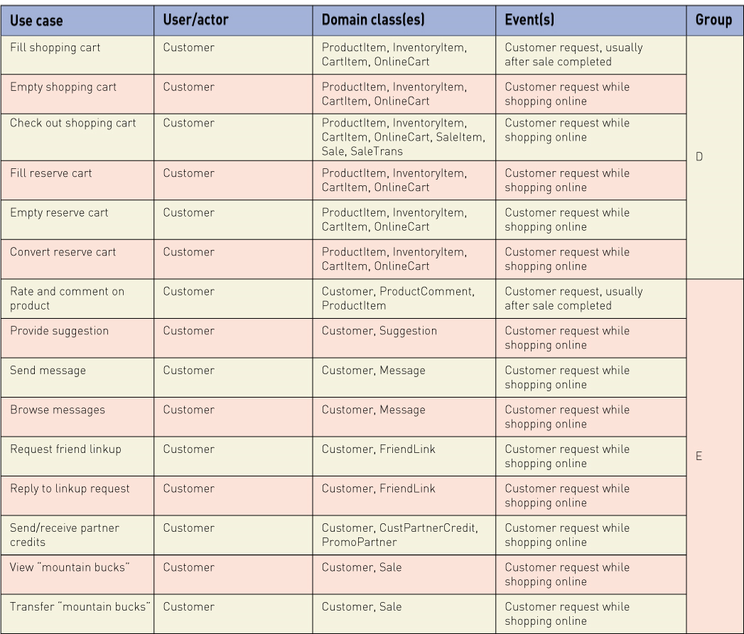
RMO CSMS Application Architecture
Grouping by customer actor – part 2

Slide 38
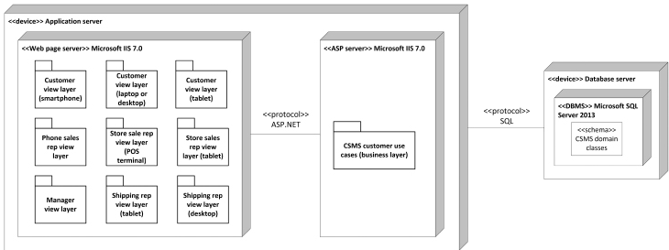
RMO CSMS Deployment Diagram
Three-layer design with user components grouped by user functions

Slide 39
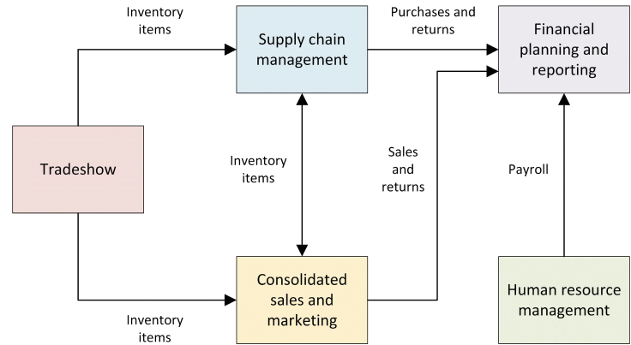
RMO CSMS Component Integration
Subsystem integration and data flows

Slide 40
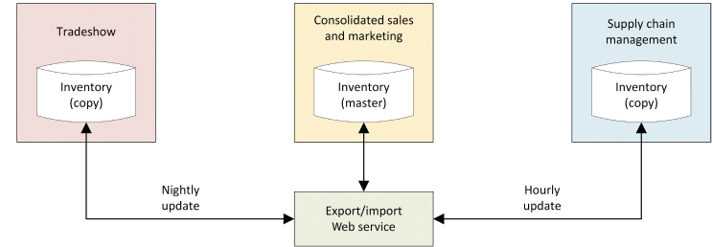
RMO CSMS Data Ownership
Who “owns” the data
System of record
What system is responsible to maintain the data
What system has a copy or can access the data

Slide 41
Summary
Anatomy of an Information System
Consist of computing devices, networks, software, and protocols
Deployed as stand-alone software, network based, Web based
Architectural Concepts
SaaS – software as a service
Web services
Distributed architectures
Client/server and three-layer architecture

Slide 42
Summary (cont.)
Interoperability
Getting all the components to work together
Architectural diagrams
Location diagrams
Network diagrams
Deployment diagrams

Slide 43
Summary (cont.)
Describing the Environment
External systems
Technology architecture
Key questions requiring answers
Designing Application Components
Application component boundaries
Grouping functions into components
System of record – who owns the data

