Slide 1

Database and Microsoft Access

Slide 2
What is a database?
A database is a tool used to organize, store, retrieve, and communicate groups of related information.

Slide 3
Examples of Business Databases
Telephone book
Student data
Music
Fingerprint database
Dictionaries
Customer data
Real estate listings
  MLS listings online
Hospital/patient data
Inventory
  Barcode scanner keeps inventory in database

Slide 4
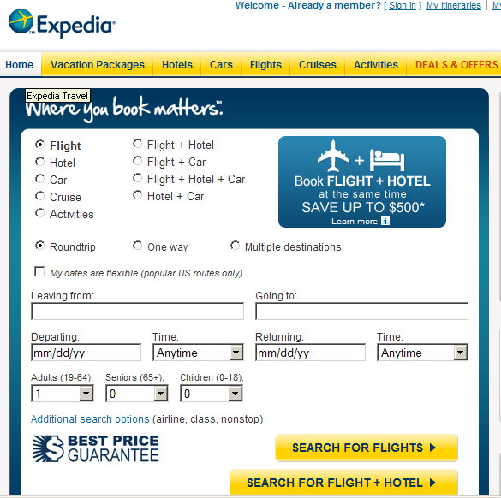
Examples
Show how to access and use for activity

Slide 5
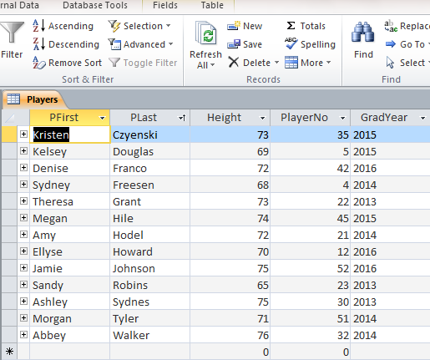
Columns & Rows
Datasheet view displays the data in columns & rows much like what is seen in an Excel spreadsheet.
A “row” represents a record.
A “column” represents a field.

Slide 6
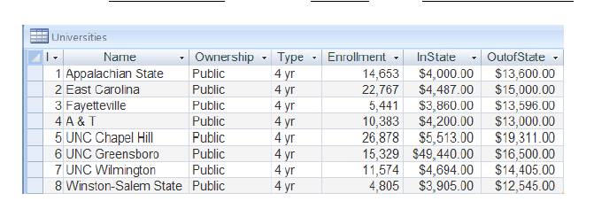
Example

Slide 7
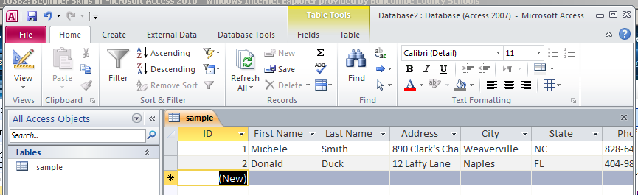
Terms…
Field Name
Cell/Entry
Record
Field

Slide 8
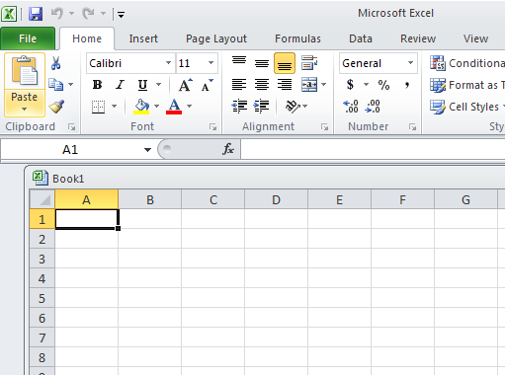
Database vs. Spreadsheet
Databases are more powerful allowing for information to be retrieved based upon criteria, calculations, etc.
database
spreadsheet

Slide 9
What makes a database?
Databases consist of four objects:
Tables store data in rows and columns*
Queries retrieve and process data
Forms control data entry and data views
  Customized manner of inputting data into a database or presenting data on a screen
Reports summarize and print data
*In this objective, our focus is on tables

Slide 10
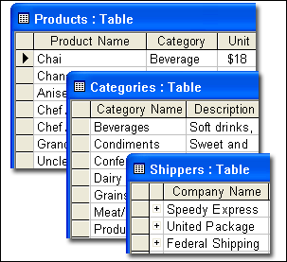
Tables: the Building Blocks of all Databases
Tables store data, so they’re essential building blocks of any database.
All databases contain at least one table
A database should have a separate table for every major subject, such as for employee records or customer orders. Data should not be duplicated in multiple tables.
Tables contain Rows called Records and Columns called Fields.
Tables organize data
Each database consists of one or more tables

Slide 11
Components of a
Database Table
Record – A group of related fields of information. Everything on one row is a record
Field – One item or bit of information in a record; represented by a COLUMN. Comprised of entries
Entry – Data typed into a field. Made up of characters. Example: John Doe is an entry in the name field. Also known as data.

Slide 12
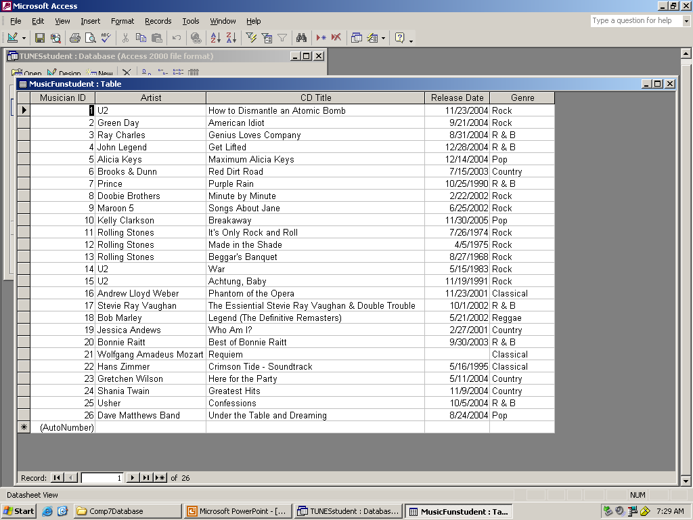
Database Tables: The Big Picture
Records
Fields
Entry
2. Columns - FIELDS
1. Rows – RECORDS
3. Cells - ENTRIES
To calculate the number of entries in a database multiply the number of fields by the number of records. Ex. 5*26= 130 entries in this database.

Slide 13
Discussion
Name
Birth date
Social Security No.
Street
City
State
Zip
Phone
Each item on the left is classified as a/an:
Table
Record
Field
Entry

Slide 14
Discussion
Susan Almond
10/22/1985
245-88-9845
31 Bessemer St.
Greensboro
NC
25233
336-585-5646
Each item on the left is classified as a/an:
Table
Record
Field
Entry

Slide 15
Discussion
Susan Almond
10/22/1985
245-88-9845
31 Bessemer St.
Greensboro
NC
25233
336-585-5646
All of the information about Susan Almond is classified as a/an:
Table
Record
Field
Entry

Slide 16
Discussion
Information about multiple employees is classified as a/an:
Table
Record
Field
Entry

Slide 17
Susan’s Record
One record is displayed from the Employee Table above. The table contains 8 fields.
Name | Bday | SS | Street | City | St | Zip | Phone
Almond, Susan | 10/22/1985 | 245-88-9845 | 31 Bessemer St | Greensboro | NC | 25233 | 336-585-5646

Slide 18
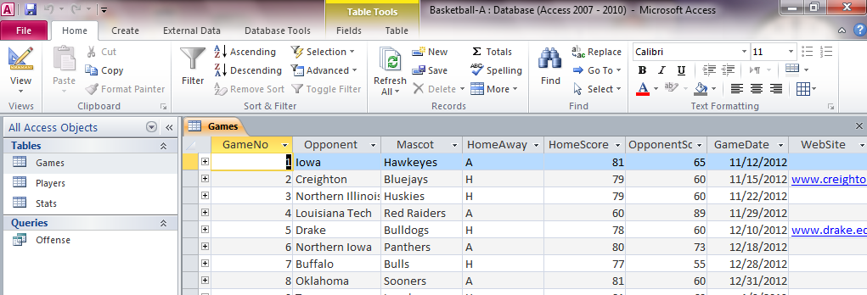
Open & Close an Object
The Navigation Pane does not display any groups that are empty.
By default, objects in the Navigation Pane are organized by Table.
Double-Click an object in the Navigation Pane to open the object
You can select open objects using the object table that appears below the ribbon area
The currently selected object’s tab appears in yellow
Close an object by choosing the close button on the upper right corner of the object window

Slide 19
Differences between
Design View & Datasheet View
Datasheet view shows the data in the database. It also allows you to enter and edit the data. It does not let you change the format of the database, other than minor changes (such as displayed column widths).
Design view allows you to create or change the table, form, or other database object, and configure the fields. You can also set keys and restrict the values entered here. But you can't change the database data in design view.
You don't use one or the other exclusively. You constantly switch back and forth between them while designing your database

Slide 20
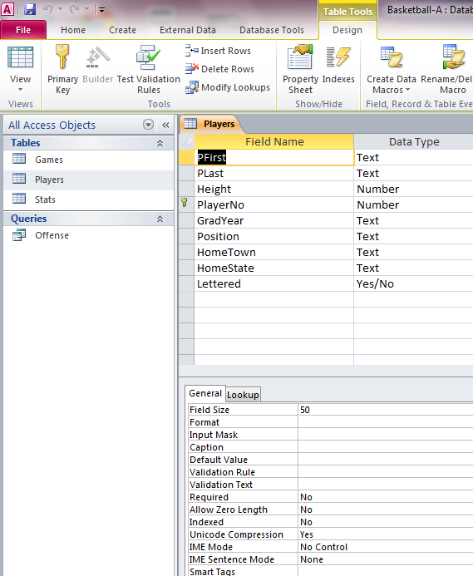
Design View
Design view displays the background structure of the object.
Design view may be used to modify the underlying design of the object.
ALL OBJECTS can be opened in Design View.
Field Name
Data Types
This is how a Table looks in Design View
Properties

Slide 21
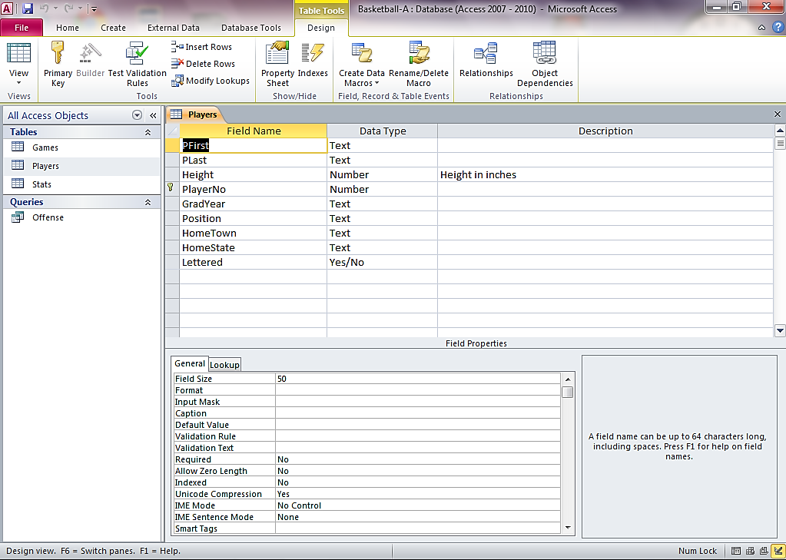
Switch between Design & Data Views

Slide 22
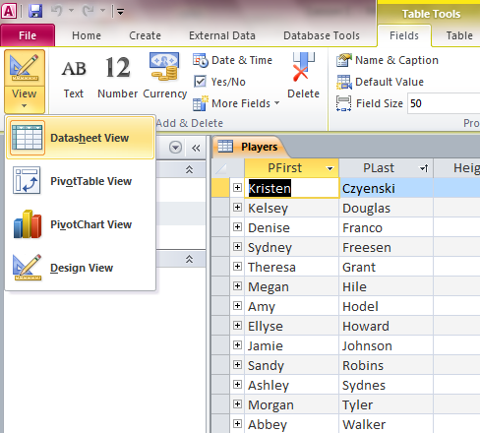
Switch between Design & Data View

Slide 23
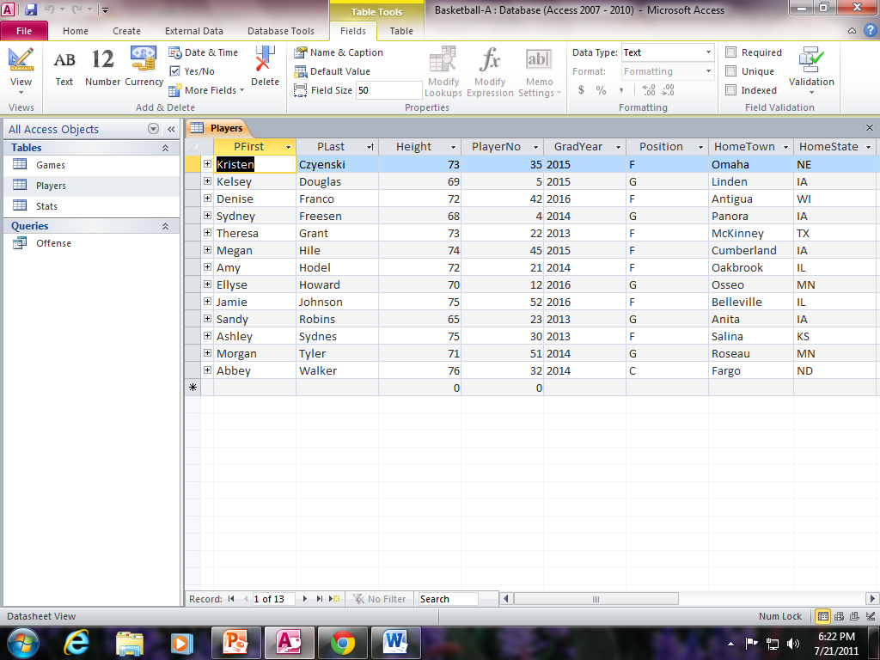
Navigate in Datasheet View
Navigate using the mouse and/or the navigation buttons
Can also navigate by using the keyboard arrow keys
Scroll Bars can be used to navigate
Navigation Buttons
HOT KEY
Tab Key = moves 1 field to the right
Shift + Tab = Moves one field to the left
Total Number of Records

Slide 24
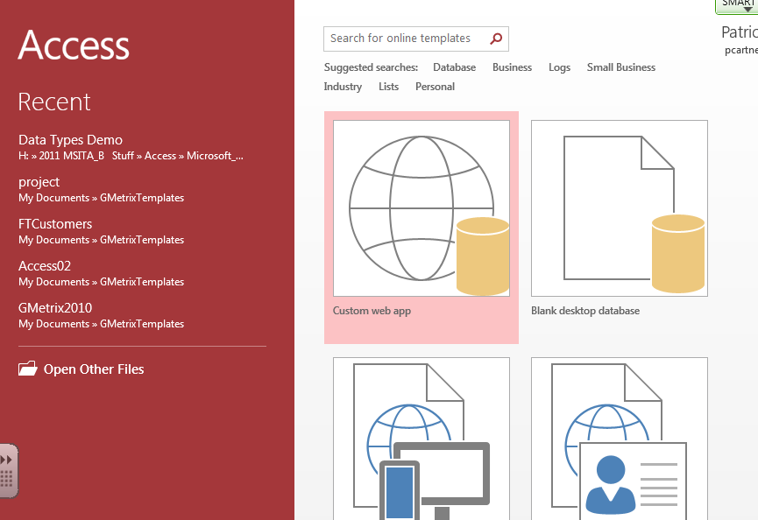
What you see after you open Access…
The screen that appears immediately after opening Microsoft Access 2016 is the Backstage View.

Slide 25
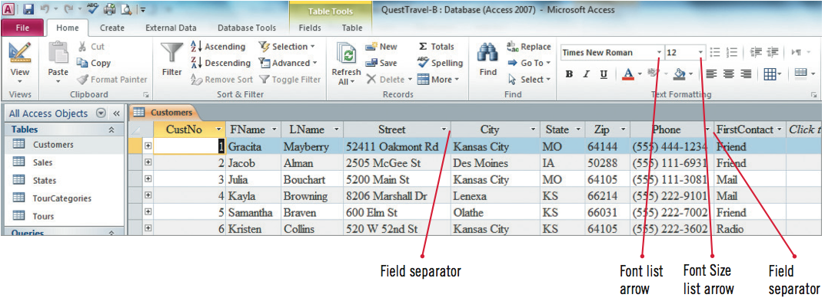
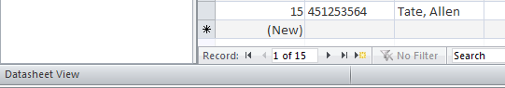
Parts of the Access Ribbon
Quick Access Toolbar
Contextual Command Tab
Group
Tab
Navigation Pane
Status Bar (can be turned on or off) File/Options

Slide 26
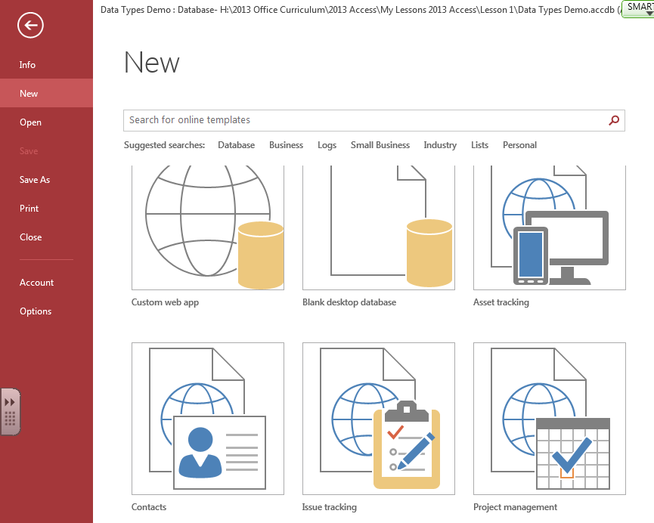
Available Templates & Office.com

Slide 27
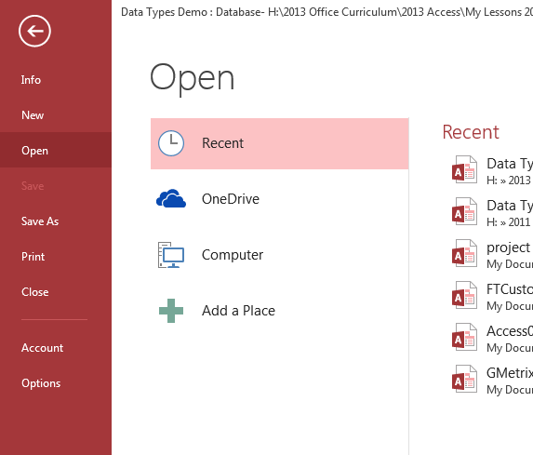
How to open an existing database using Open from File Tab.

Slide 28
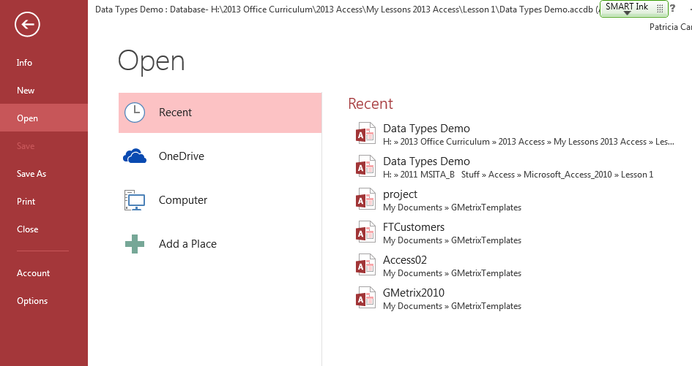
Open a recent database using “Recent Command”

Slide 29
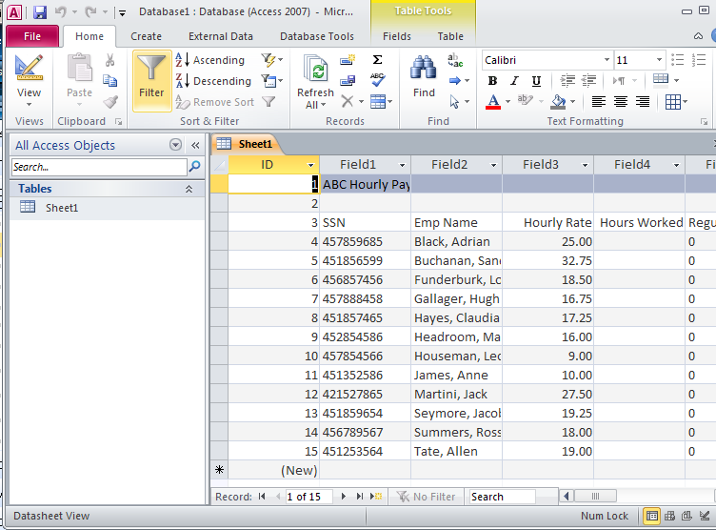
It opens in “Datasheet View”

Slide 30
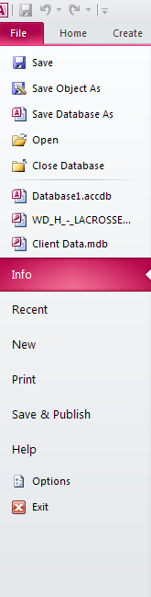

File Tab…

Slide 31


Quick Access Toolbar

