Slide 1
Database Design
IT5507 Fundamentals of Data Science
WeITec, Te Whare Wānanga o te Awakairangi | Xi’an Kedagaoxin University

Slide 2
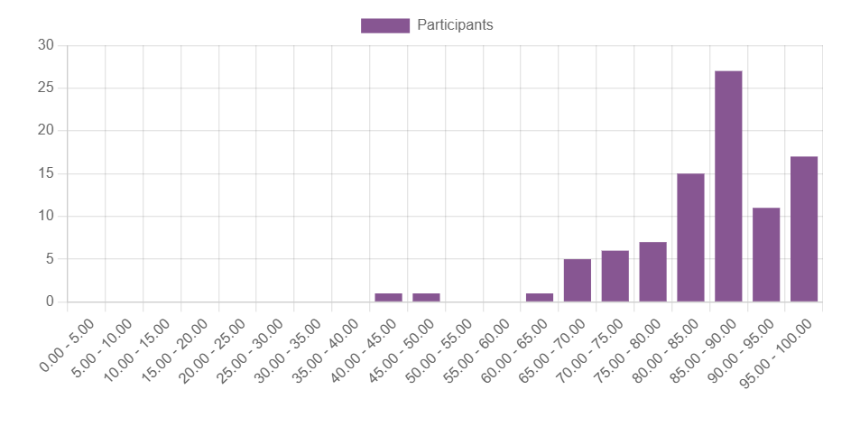
About Test 1

Slide 3
Learning Objectives
By the end of this chapter, you will be able to:
  Understand the role of database design in information systems.
  Describe the Systems Development Life Cycle (SDLC) and Database Life Cycle (DBLC).
  Differentiate between top-down and bottom-up design approaches.
  Compare centralized and decentralized database design.

Slide 4
What is an Information System?
Definition: A system that collects, stores, and retrieves data using:
  People, Hardware, Software (e.g., retail POS systems).
  Databases, Applications, Procedures (e.g., hospital patient records).
  Key Processes:
  Systems Analysis: Assess needs (e.g., CRM requirements).
  Systems Development: Build the system (e.g., e-commerce platform).

Slide 5
Systems Development Life Cycle (SDLC)
5 Phases:
  Planning – Overview of company objectives.
  Analysis – Detailed problem examination.
  Design – System process specifications.
  Implementation – Install hardware/software, deploy database.
  Maintenance – Fix issues, adapt to changes.
  Note: Iterative process, not strictly linear.

Slide 6
Database Life Cycle (DBLC)
6 Phases:
  Initial Study – Define problems and scope.
  Design – Conceptual, logical, and physical design.
  Implementation – Install DBMS, load data.
  Testing – Evaluate performance, fine-tune.
  Operation – Monitor and resolve issues.
  Maintenance – Updates, backups, optimizations.

Slide 7
Conceptual Design
Goal: Design a database without technical constraints.
Steps:
Analyze data requirements (e.g., user views).
Create ER diagrams (e.g., Student, Course entities).
Normalize data to avoid redundancy.
Verify the model aligns with business rules.
Example:
University database with Student, Course, and Professor entities.

Slide 8
Logical Design
Goal: Map conceptual design to a specific data model (e.g., relational).
Steps:
Convert ER diagrams to tables.
Validate using normalization.
Ensure integrity (e.g., primary/foreign keys).
Meet user requirements.
Example:
Student table with StudentID (PK), Name, EnrollmentDate.

Slide 9
Physical Design
Focus: Storage, security, and performance.
Activities:
Organize data storage (e.g., tables, indexes).
Define security measures (e.g., user access controls).
Optimize performance (e.g., query tuning).
Example:
Indexing StudentID for faster searches.

Slide 10
Design Strategies
Top-Down: Start with high-level entities, then define attributes.
  Example: Begin with Department, then add Employee details.
Bottom-Up: Start with attributes, group into entities.
  Example: Define ProductID, Price, then create Product table.

Slide 12
Centralized vs. Decentralized Design
Centralized | Decentralized
Single team designs entire database. | Teams design subsets, later combined.
Best for small-scale systems. | Used in large, complex systems.
Example: Small retail inventory. | Example: Multinational corporation.
Challenges in Decentralized:
Synonyms (same entity, different names).
Homonyms (same name, different entities).

Slide 15
Common Database Failures
Source | Example
Software | Oracle vulnerability allowing data deletion.
Hardware | Disk crash causing data loss.
External Factors | Lightning strike disrupting backups.
Solution: Regular backups and testing.

Slide 16
Summary
Databases are core to information systems.
SDLC and DBLC guide system and database development.
Design approaches vary (top-down/bottom-up, centralized/decentralized).
Proper design ensures efficiency, security, and scalability.

Slide 17
Business Intelligence and Data Warehouses
IT5507 Fundamentals of Data Science

Slide 18
Learning Objectives
Describe the role of business intelligence in decision support.
Understand the architecture and components of BI systems.
Differentiate between operational and decision support data.
Explore data warehouses, star schemas, and OLAP.
Learn about data analytics, mining, and visualization.

Slide 19
Why Data Analysis Matters
Organizations grow by understanding their environment.
Track daily transactions and analyze company data.
Business intelligence (BI) provides actionable insights for better decisions.
raw data → analysis → insights → decisions

Slide 20
What is Business Intelligence?
A set of tools and processes to capture, store, and analyze data.
Transforms data into information, knowledge, and wisdom.
Supports decision-making at all levels.

Slide 21
Components of BI Architecture
People: Analysts, managers, decision-makers.
Processes: Data collection, analysis, interpretation.
Management: Oversight and coordination.
Governance: Policies for quality and security.

Slide 22
Benefits of Business Intelligence
Improved decision-making.
Unified platform for data integration.
User-friendly interfaces for all users.
Centralized data reduces discrepancies.
Identifies trends and opportunities.

Slide 23
The Evolution of BI
From static reports to dynamic dashboards.
Transition to mobile BI and Big Data analytics.
Accelerated adoption due to technological advancements.

Slide 24
Operational Data vs. Decision Support Data
Operational Data: Real-time, detailed, transactional.
Decision Support Data: Historical, summarized, multidimensional.

Slide 25
What is a Data Warehouse?
Centralized repository for integrated data.
Subject-oriented, time-variant, nonvolatile.
Supports decision-making processes.

Slide 26
Star Schema Explained
Facts: Numeric values (e.g., sales).
Dimensions: Qualifying characteristics (e.g., time, product).
Attributes: Used for filtering and classification.
Data-modeling technique
Maps multidimensional decision support data into a relational database
Creates the near equivalent of multidimensional database schema from existing relational database
Yields an easily implemented model for multidimensional data analysis

Slide 27
Online Analytical Processing (OLAP)
Multidimensional data analysis.
Advanced database support for large datasets.
Easy-to-use interfaces for exploration.

Slide 30
Data Analytics in BI
Explanatory analytics: Discover patterns.
Predictive analytics: Forecast future outcomes.
Tools: Statistical models, AI, machine learning.

Slide 32
SQL for Data Analysis
ROLLUP: Generates subtotals and grand totals.
CUBE: Aggregates data across multiple dimensions.
Materialized views: Precomputed summaries for faster queries.

Slide 33
The Power of Data Visualization
Visual representations enhance understanding.
Tools allow zooming, filtering, and drilling down.
Combines cognitive science with aesthetics

Slide 34
Key Takeaways
BI transforms raw data into actionable insights.
Data warehouses support decision-making.
Star schemas and OLAP enable multidimensional analysis.

